Slide 1
AI-Powered Data Insights

Slide 2






Introduction Of Team Members
Megha Sharma
kavali Tharakananda
Team Lead
Project Lead
Khuzaima Kausar
katlego masela
Project Manager
Co-Project Manager

Slide 3
Introduction of the internship
In this internship, we are working as AI Data Analysts, focusing on student engagement data. The goal is to explore how data science and machine learning can help identify which opportunities attract the most signups, which are completed successfully, and where drop-offs occur. Throughout the internship, we’re developing key skills in data cleaning, visualization, predictive modeling, and deriving insights to support better decision-making around student engagement.

Slide 4
Week 1: Data Cleaning and Feature Engineering
Dataset Overview --
The Excelerate Student Engagement Dataset captures detailed information about learners' participation, including signup timestamps, opportunity details, and demographic data such as gender and date of birth. It also includes categorical and status indicators to track the type and progress of each opportunity. This dataset provides a comprehensive foundation for analyzing student engagement patterns and behaviors.
The dataset includes the following key features --
-Learner SignUp DateTime: Timestamp of when the user signed up.
-Opportunity Id: Unique identifier for each opportunity.
-Opportunity Name: Name of the opportunity.
-

Slide 5
Opportunity Category: Category of the opportunity (e.g., Course, Event).
-Opportunity End Date: Date when the opportunity ends.
-First Name: User's first name.
-Date of Birth: User's date of birth.
-Gender: User's gender.
-Country: User's country of residence.
-Institution Name: Name of the institution the user is associated with.
-Current/Intended Major: User's current or intended major.
-Entry created at: Timestamp of when the entry was created.
-Status Description: Current status of the user.
-Status Code: Code representing the status.
-Apply Date: Date when the user applied for the opportunity.
-Opportunity Start Date: Date when the opportunity starts
Part 1: Data Cleaning
The first and foundational step in our Week 1 assignment involved cleaning the raw dataset provided. This process was crucial to ensure that our subsequent analysis and model training were based on consistent, reliable, and meaningful data. Here's a breakdown of the major cleaning procedures performed:

Slide 6
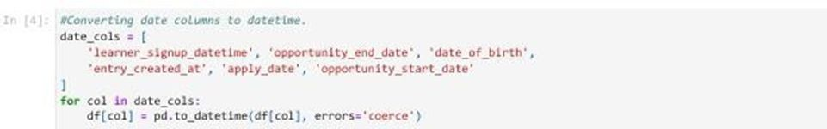
1. Standardizing Column Names --
To maintain consistency and improve code readability, all column names were reformatted. We removed whitespace, converted all names to lowercase, and replaced spaces with underscores. This uniform naming convention made the dataset easier to work with during processing.
2. Handling Date Formats --
A significant portion of the dataset involved time-based data such as sign-up dates, birthdates, and course start/end dates. These were originally stored as strings. We converted all relevant columns to proper datetime formats. This allowed for accurate computations such as age calculation and duration analysis.

Slide 7
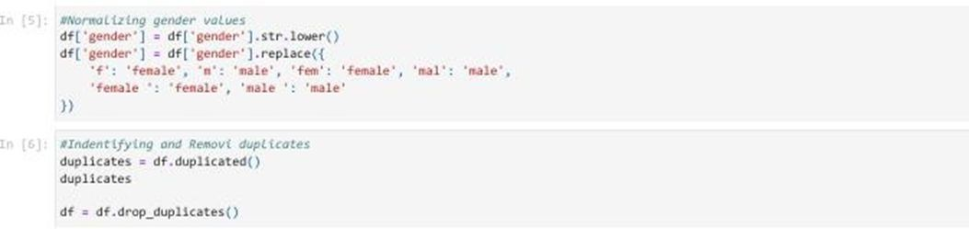
3.Cleaning Gender Values --
The gender column had inconsistent entries like "F", "fem", "Male ". These values were normalized to either
male or female, ensuring consistency for demographic analysis.
4.Removing Duplicates --
We checked for and eliminated duplicate records to prevent redundant entries from skewing any analysis. This step helped us maintain the integrity of the dataset.

Slide 8
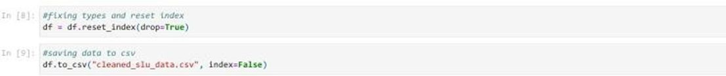
5.Deriving New Fields --
Several new columns were added to extract more insight from existing data: lAge was computed based on date of birth.
lSign-up date and month were extracted from the timestamp.
--- These transformations helped enrich the dataset with features more suitable for exploratory analysis and modeling.
6. Index Reset and Data Export --
After cleaning, we reset the dataframe index for a tidy structure and exported the cleaned version to a CSV file (cleaned_slu_data.csv) for future use.

Slide 9
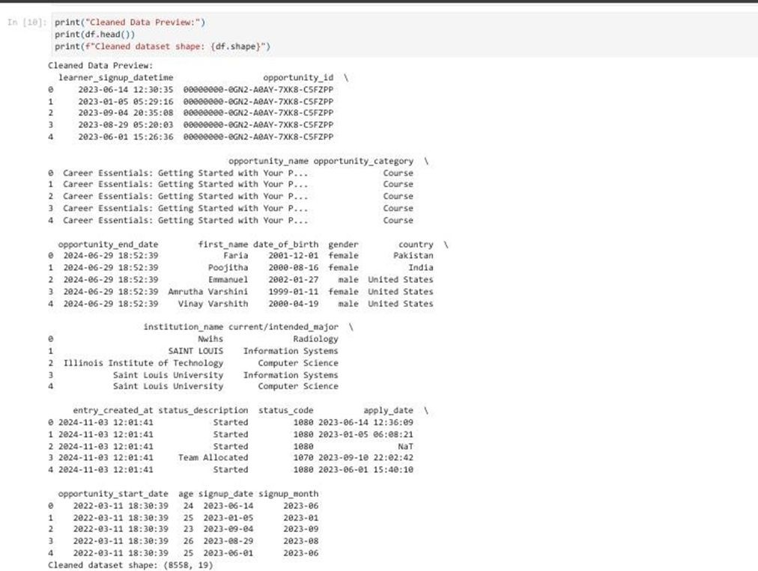
Final Cleaned Dataset: Rows: 8,558
Columns: 19

Slide 10
Part 2: Feature Engineering
Once the dataset was cleaned, the next phase involved engineering additional features that would provide deeper insights and assist in model performance.
This was a crucial step to enhance the predictive power of the data.
1.Temporal Features --
From the signup timestamp, we derived:
lSignup hour – to analyze the time of day users registered. lSignup weekday – to detect weekly patterns.
lSignup quarter – to capture seasonal trends.
These features help in identifying behavioral patterns around user engagement.
2. Age Bucketing --
We categorized users into age brackets such as '18-24', '25-34', and more, using logical bins. This grouping helps in demographic segmentation and analysis.

Slide 11
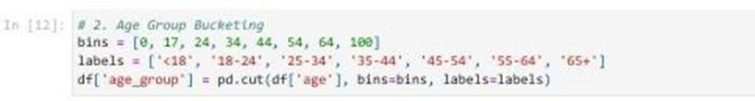
2. Age Bucketing --
We categorized users into age brackets such as '18-24', '25-34', and more, using logical bins. This grouping helps in demographic segmentation and analysis.
3.Opportunity Metrics --
lCompletion time (in days): Calculated as the difference between signup date and opportunity end date. lOpportunity duration: Measured from the start to end date of the opportunity.
lCompletion status: A new boolean feature, is_completed, was created by checking whether the user's status included the word "completed".

Slide 12
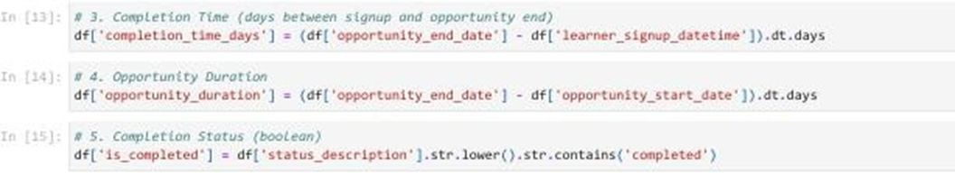
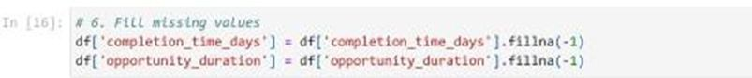
These engineered variables are particularly useful for evaluating course engagement and performance trends.
4. Handling Missing Values --
We addressed missing data in the new features by using placeholders like -1, especially for metrics like opportunity duration where data might be incomplete. This prevented the loss of valuable entries during model training.

Slide 13
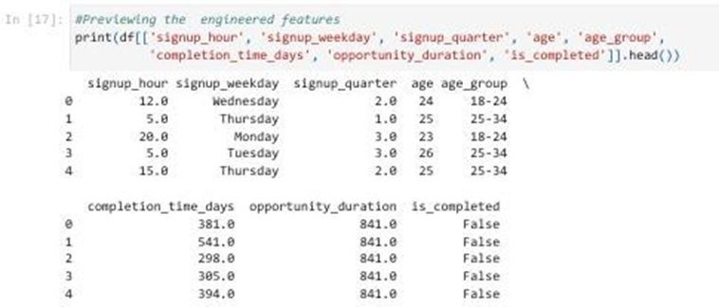
5.Preview of Engineered Features --
A subset of columns was examined to verify the correctness of the feature engineering process. Key columns included:
lsignup_hour
lsignup_weekday lage_group lcompletion_time_days lopportunity_duration lis_completed

Slide 14
a)Summary of Outcomes
By the end of Week 1:
lWe transformed a messy dataset into a structured and meaningful form. lKey time-based and categorical fields were normalized and enriched.
lNew features were engineered to capture user behavior, engagement timing, and course dynamics.
lThe refined dataset was now fully prepared for exploratory data analysis (EDA) and predictive modeling in the upcoming weeks.
b)Why This Matters
Clean, structured data is the cornerstone of any successful data science project. Without accurate preprocessing:
lInsights from EDA may be misleading.
lMachine learning models can perform poorly or exhibit bias. lBusiness decisions may be based on faulty assumptions.

Slide 15
Week 2 – Data Visualisation and Analysis
New Feature Creation
# Convert date columns to datetime
data['Opportunity Start Date'] = pd.to_datetime(data['Opportunity Start Date'], errors='coerce')
# Add Completion Date
data['Completion Date'] = data['Opportunity Start Date'] + pd.to_timedelta(data['Engagement_Duration_Days'], unit='D')

Slide 16
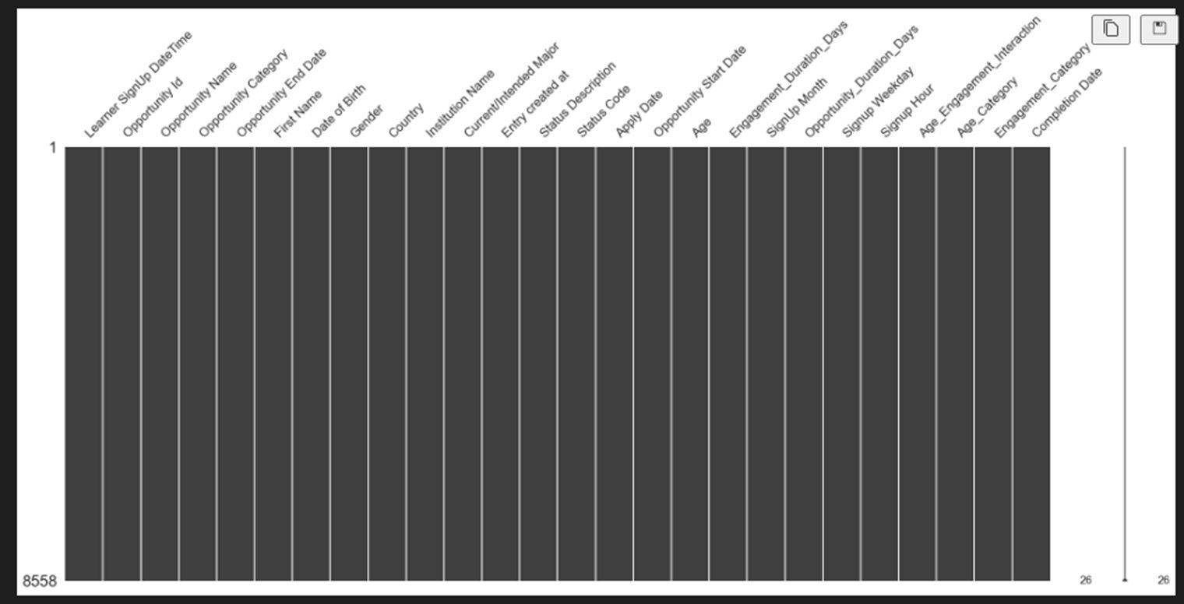
No Missing Values import missingno as msno msno.matrix(data) plt.show()

Slide 17
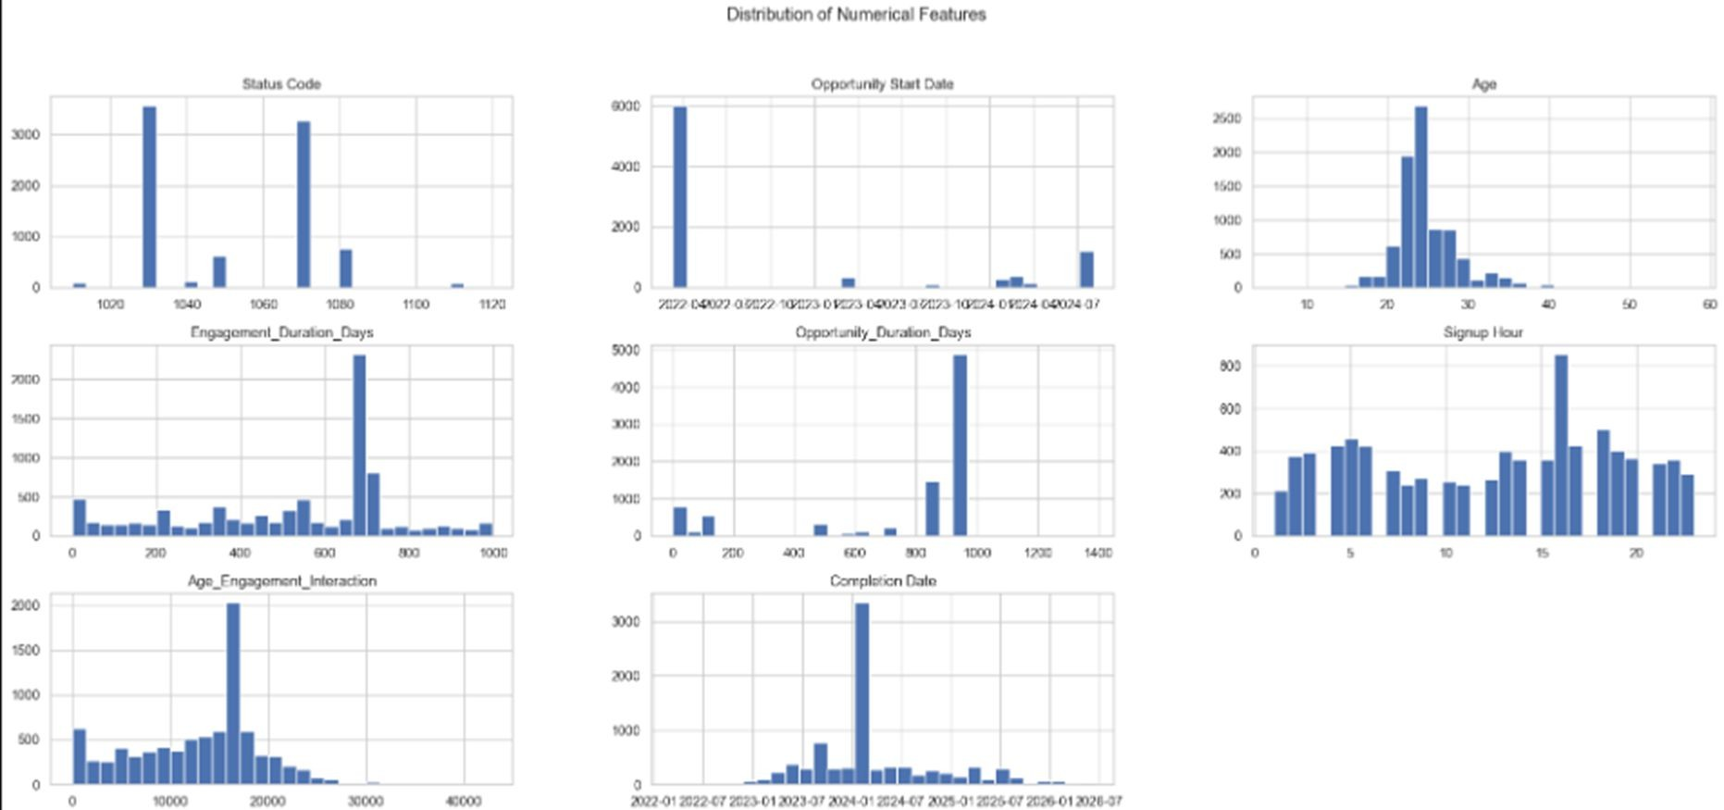
Distribution of Numerical Features

Slide 18
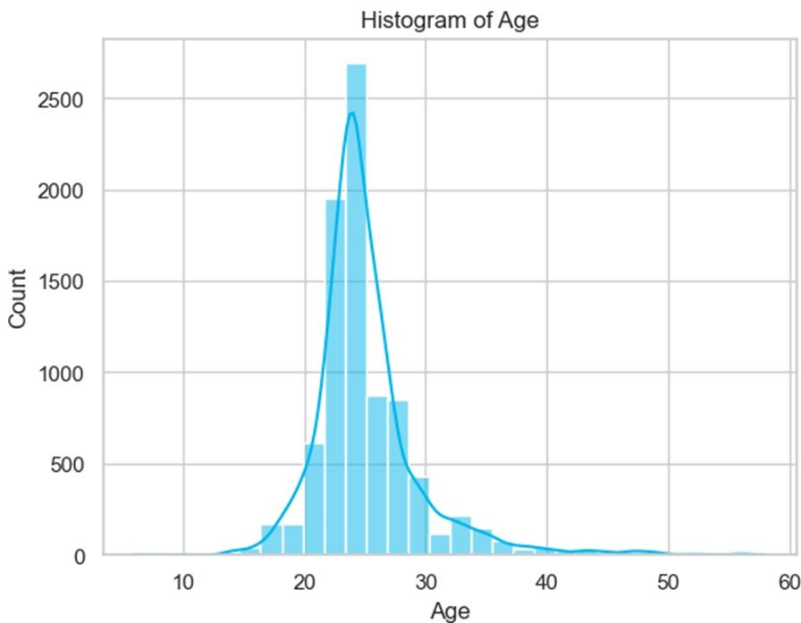
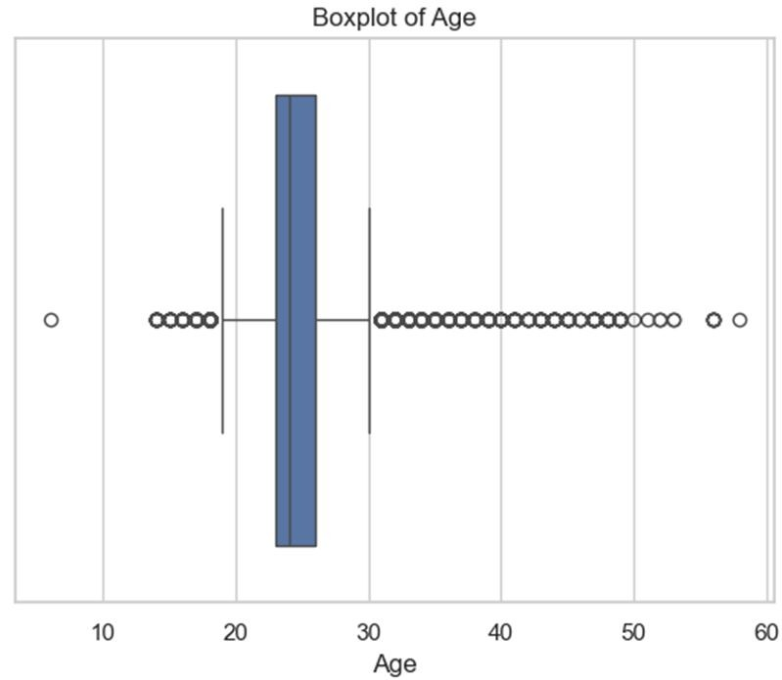
How the data is distributed among different ages and the outliers

Slide 19
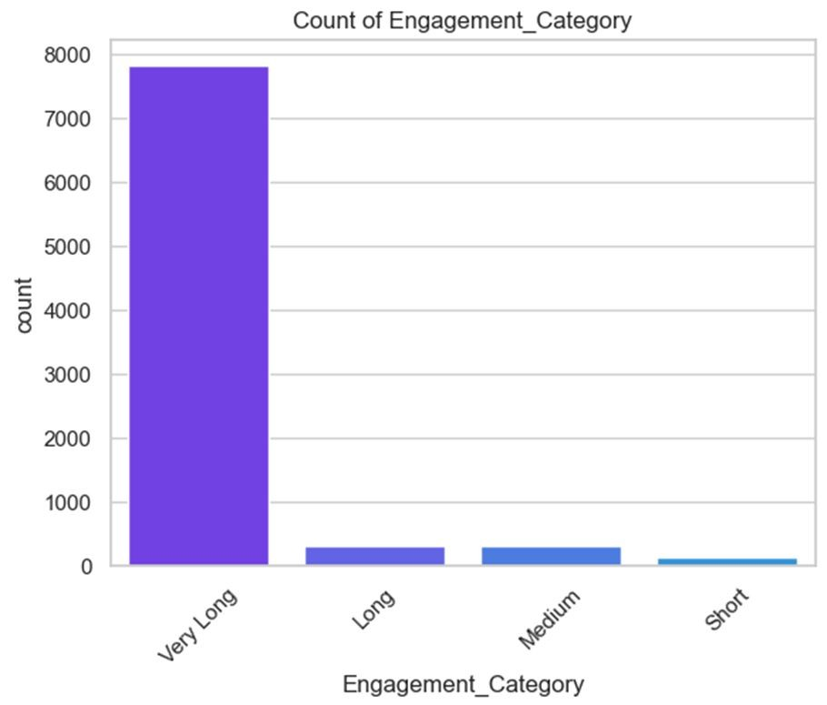
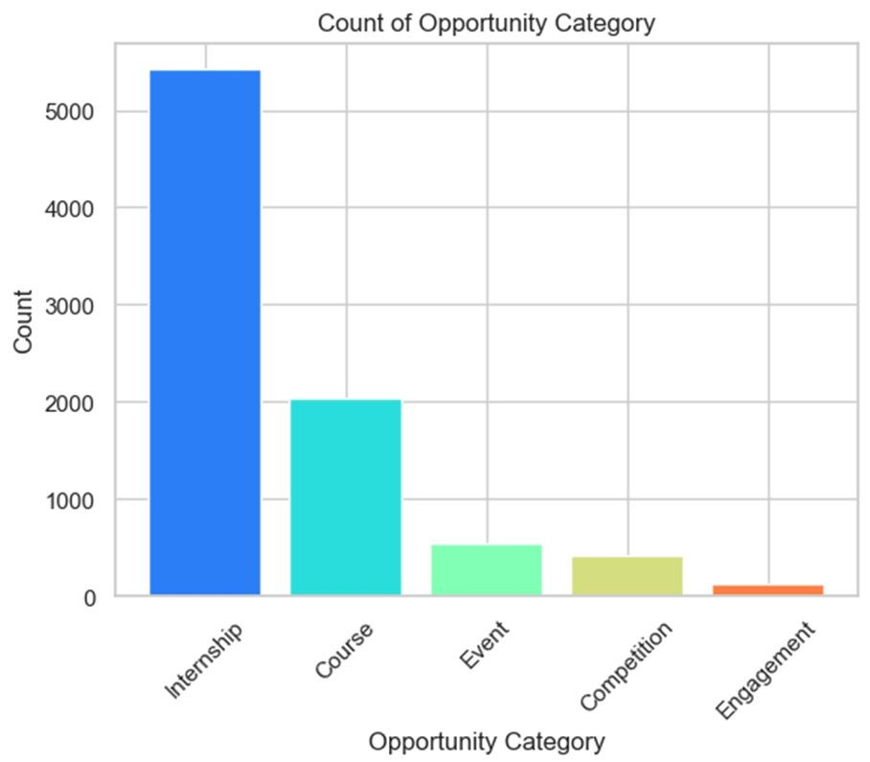
Count of Engagement and Opportunity categories

Slide 20
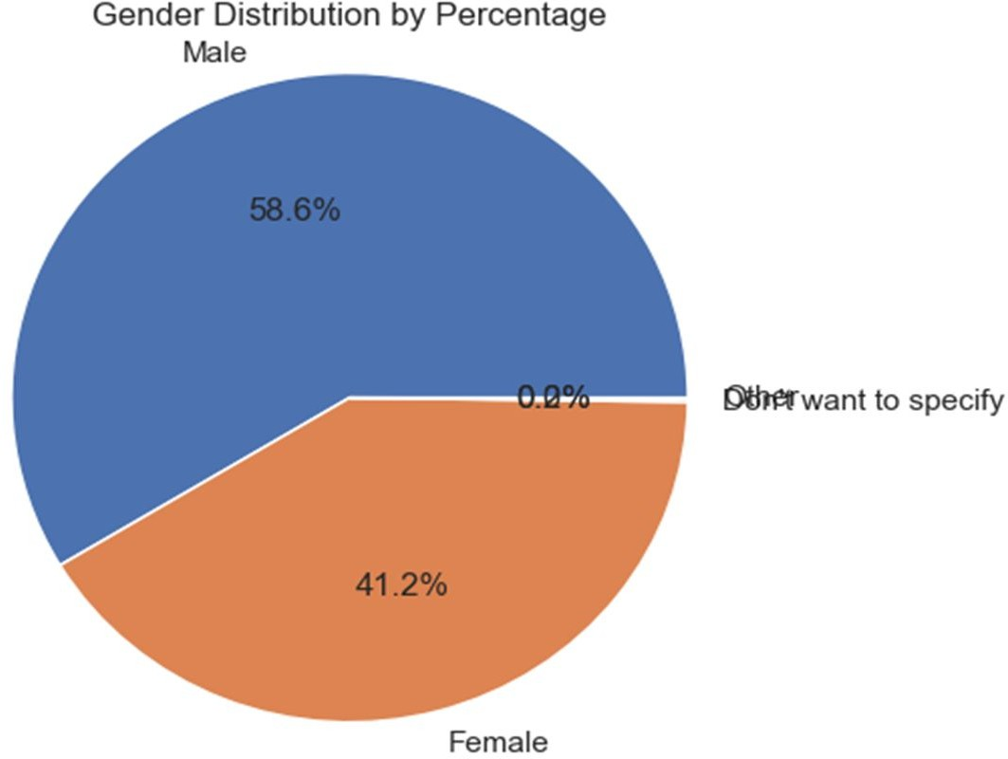
Gender Distribution by Percentage

Slide 21
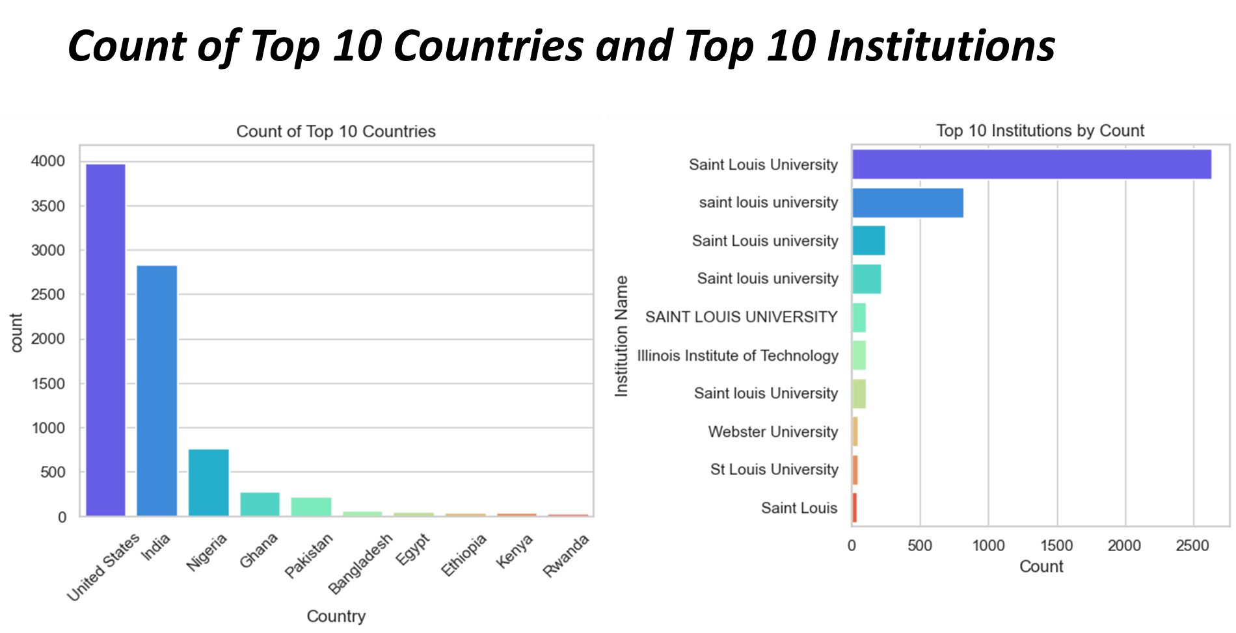

Slide 22
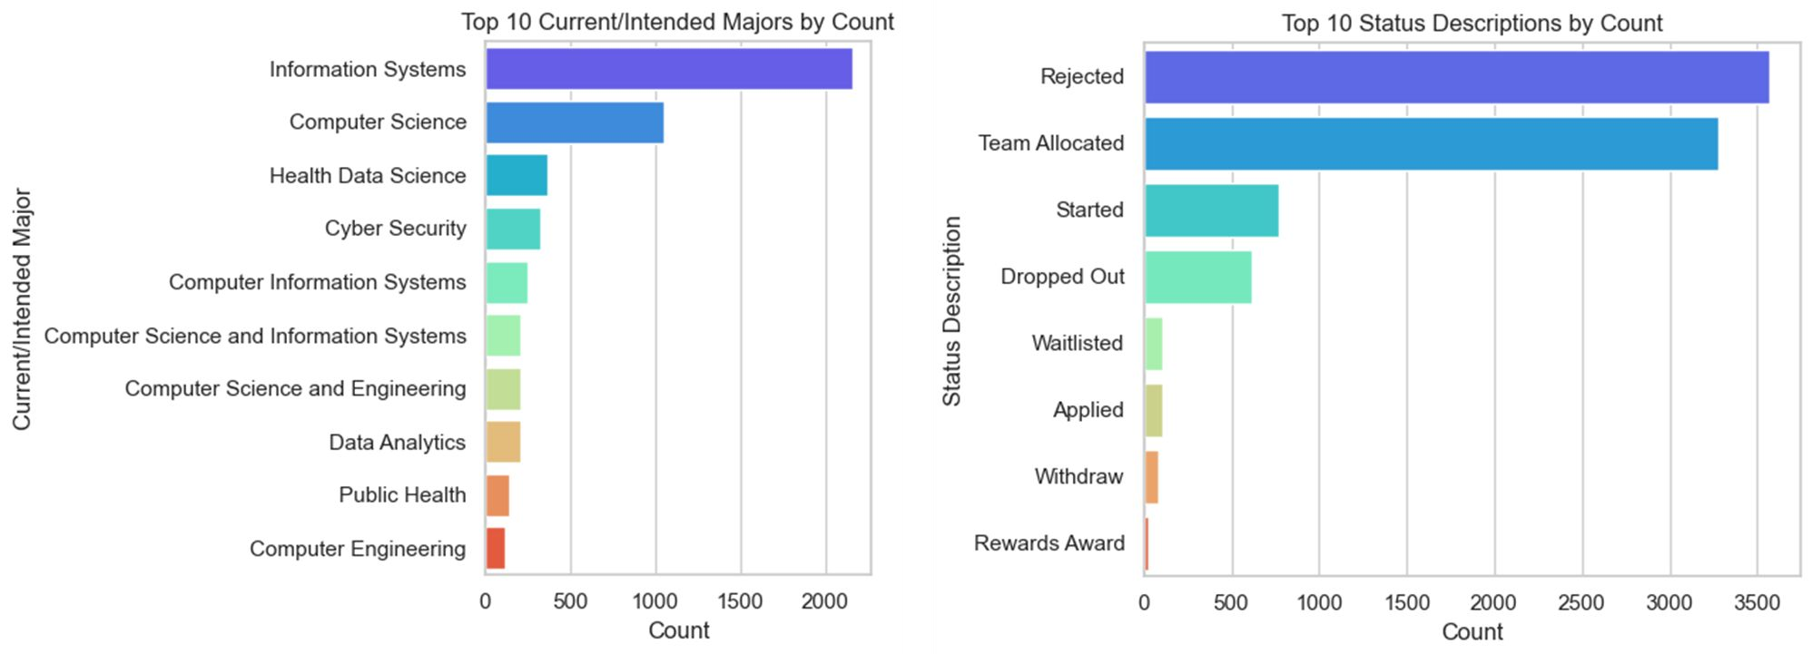
Top 10 Current/Intended Majors by Count Top 10 Status Descriptions by Count

Slide 23
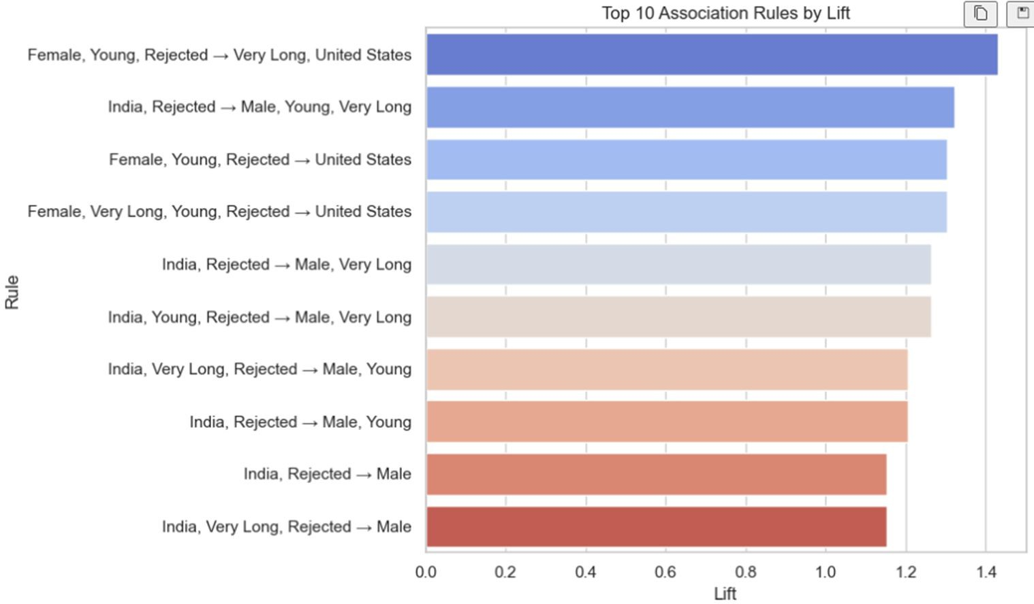
Mined Categorical Pattern

Slide 24
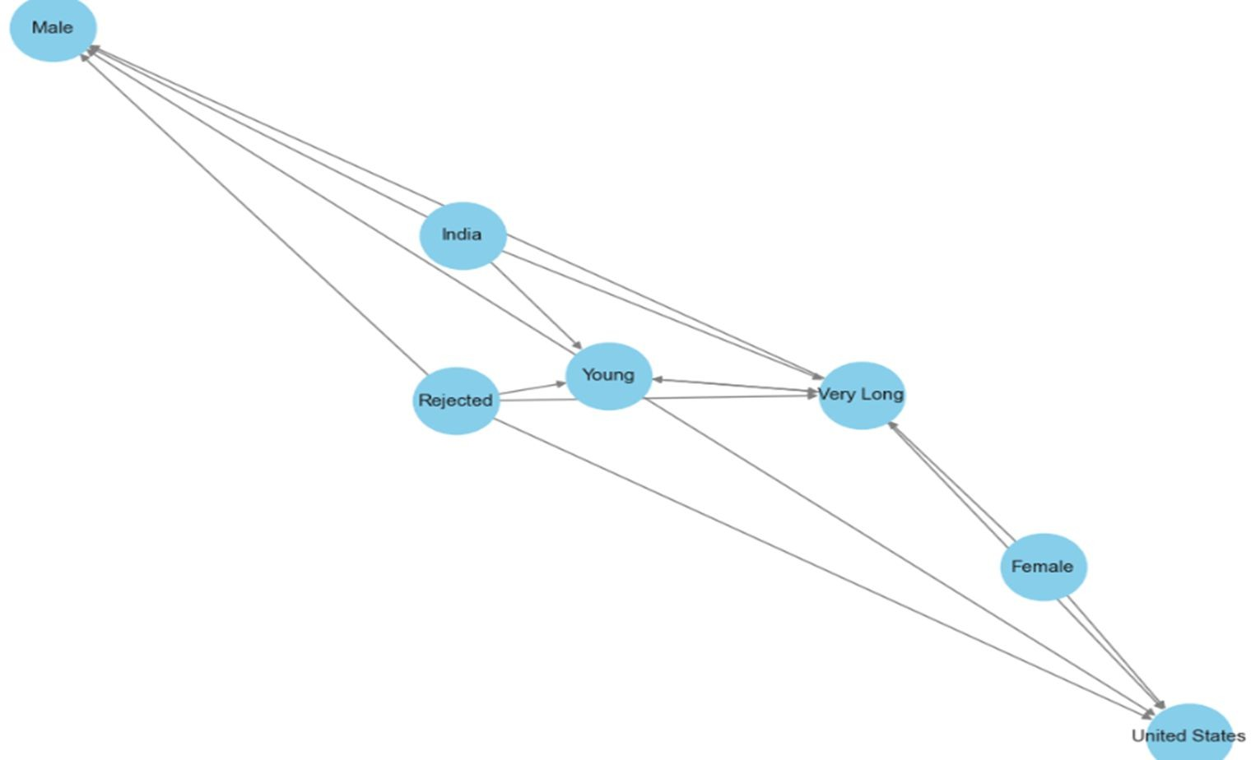
Association Rule Network Graph

Slide 25
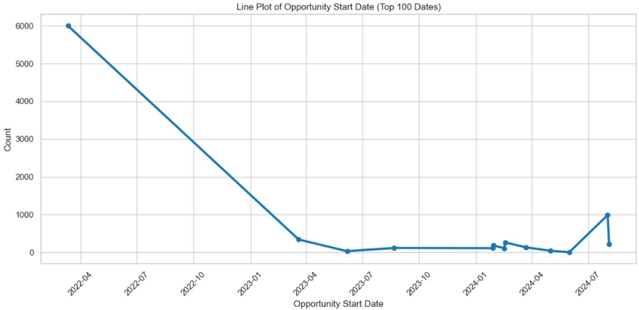
Line Plot of Opportunity Start Date (Top 100 Dates

Slide 26
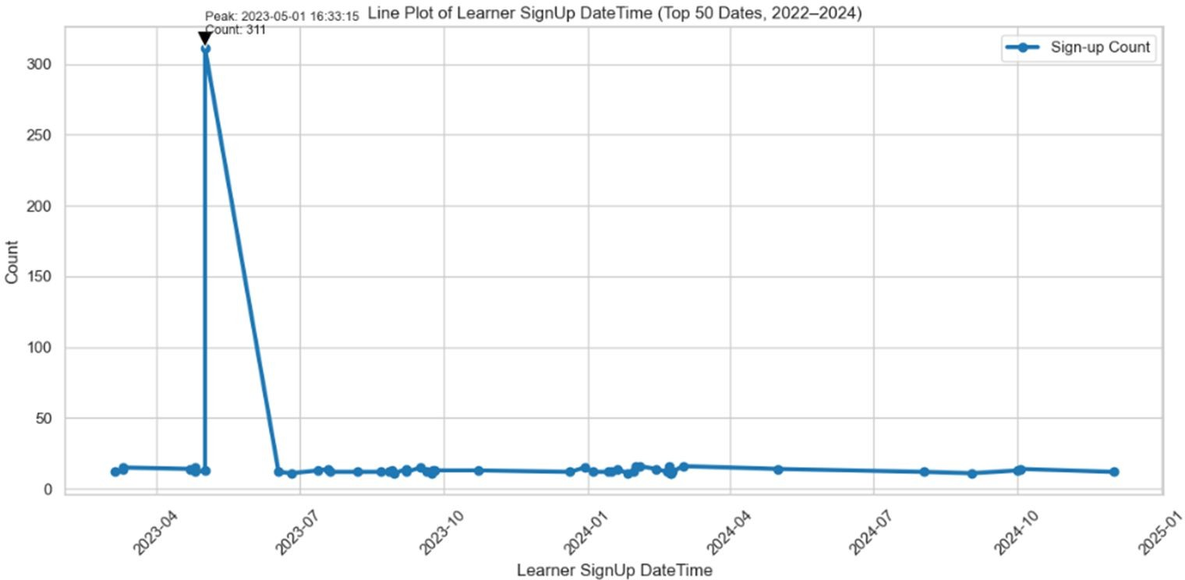
Line Plot of Learner SignUp DateTime (Top 50 Dates, 2022–2024)

Slide 27
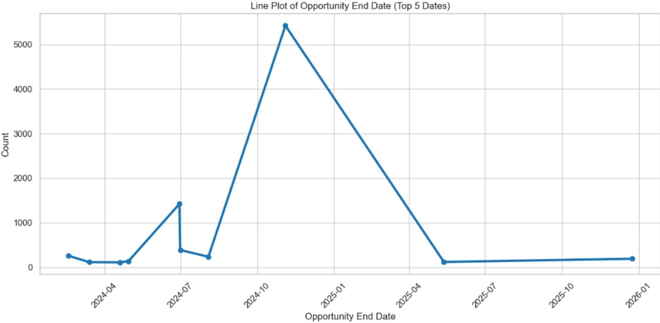
Line Plot of Opportunity End Date (Top 5 Dates)

Slide 28
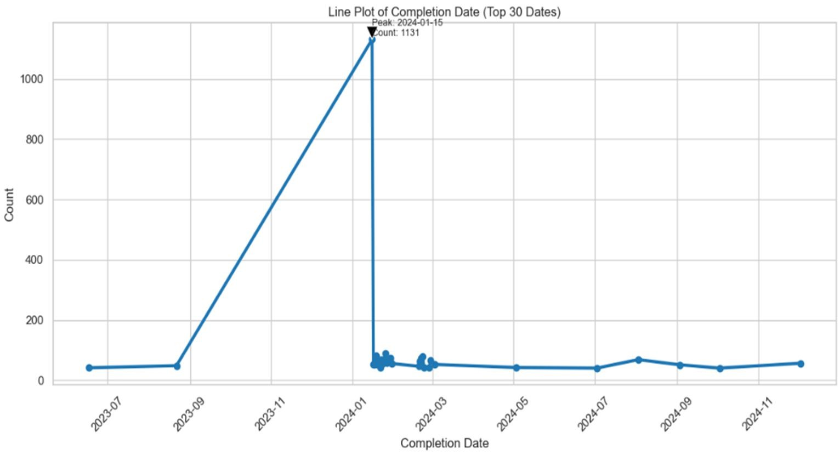
Line Plot of Completion Date (Top 30 Dates)

Slide 29
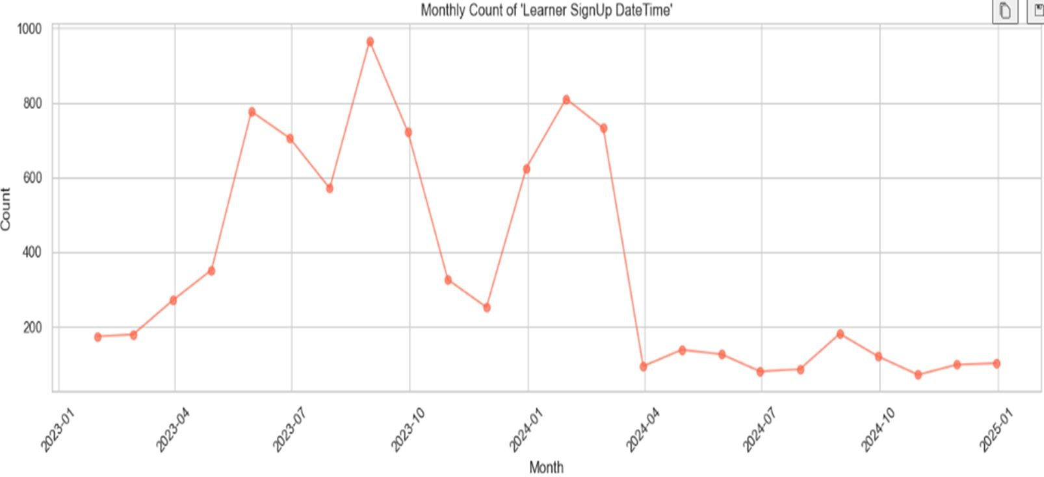
Monthly Count of 'Learner SignUp DateTime

Slide 30
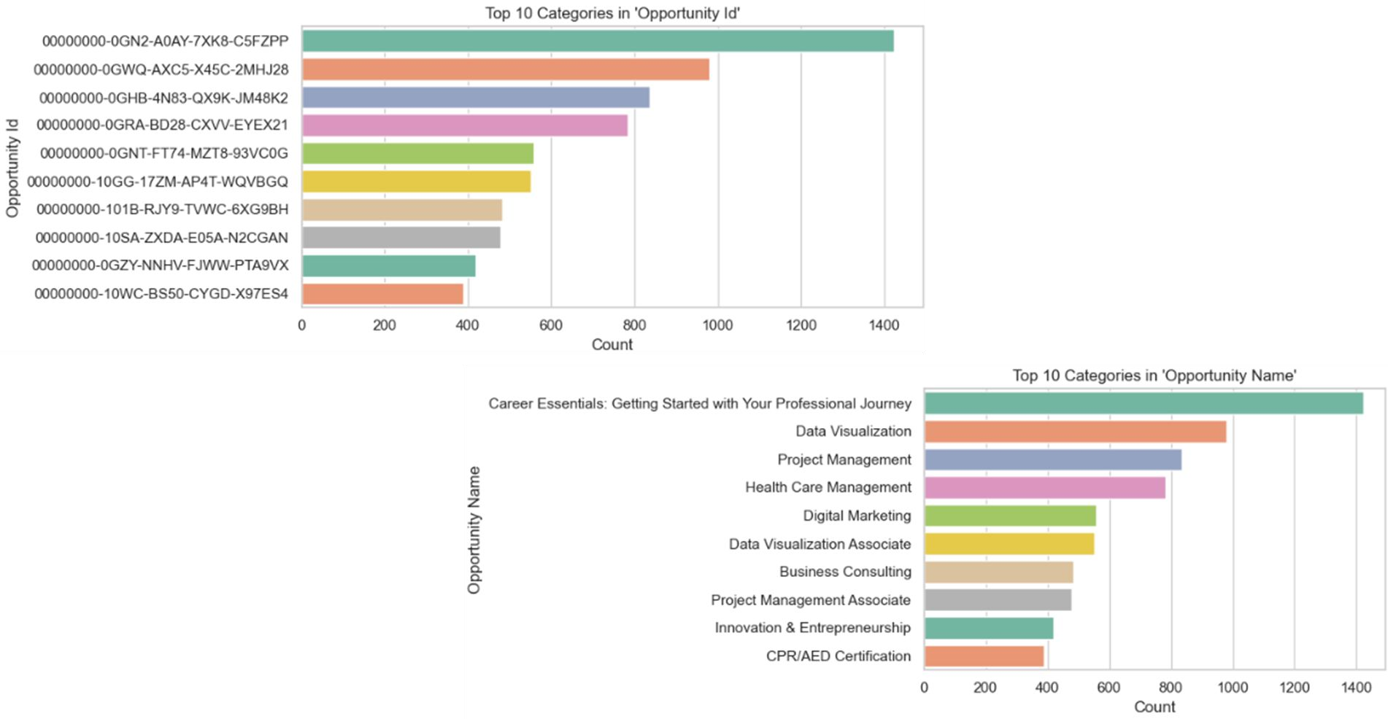
Top 10 Categories in Opportunity IDs and Names

Slide 31
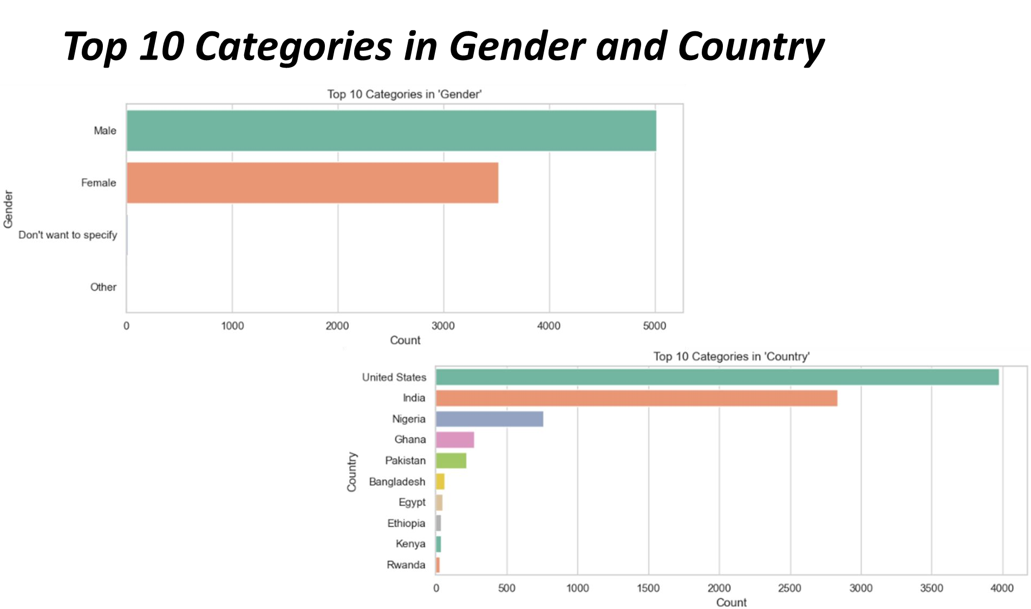

Slide 32
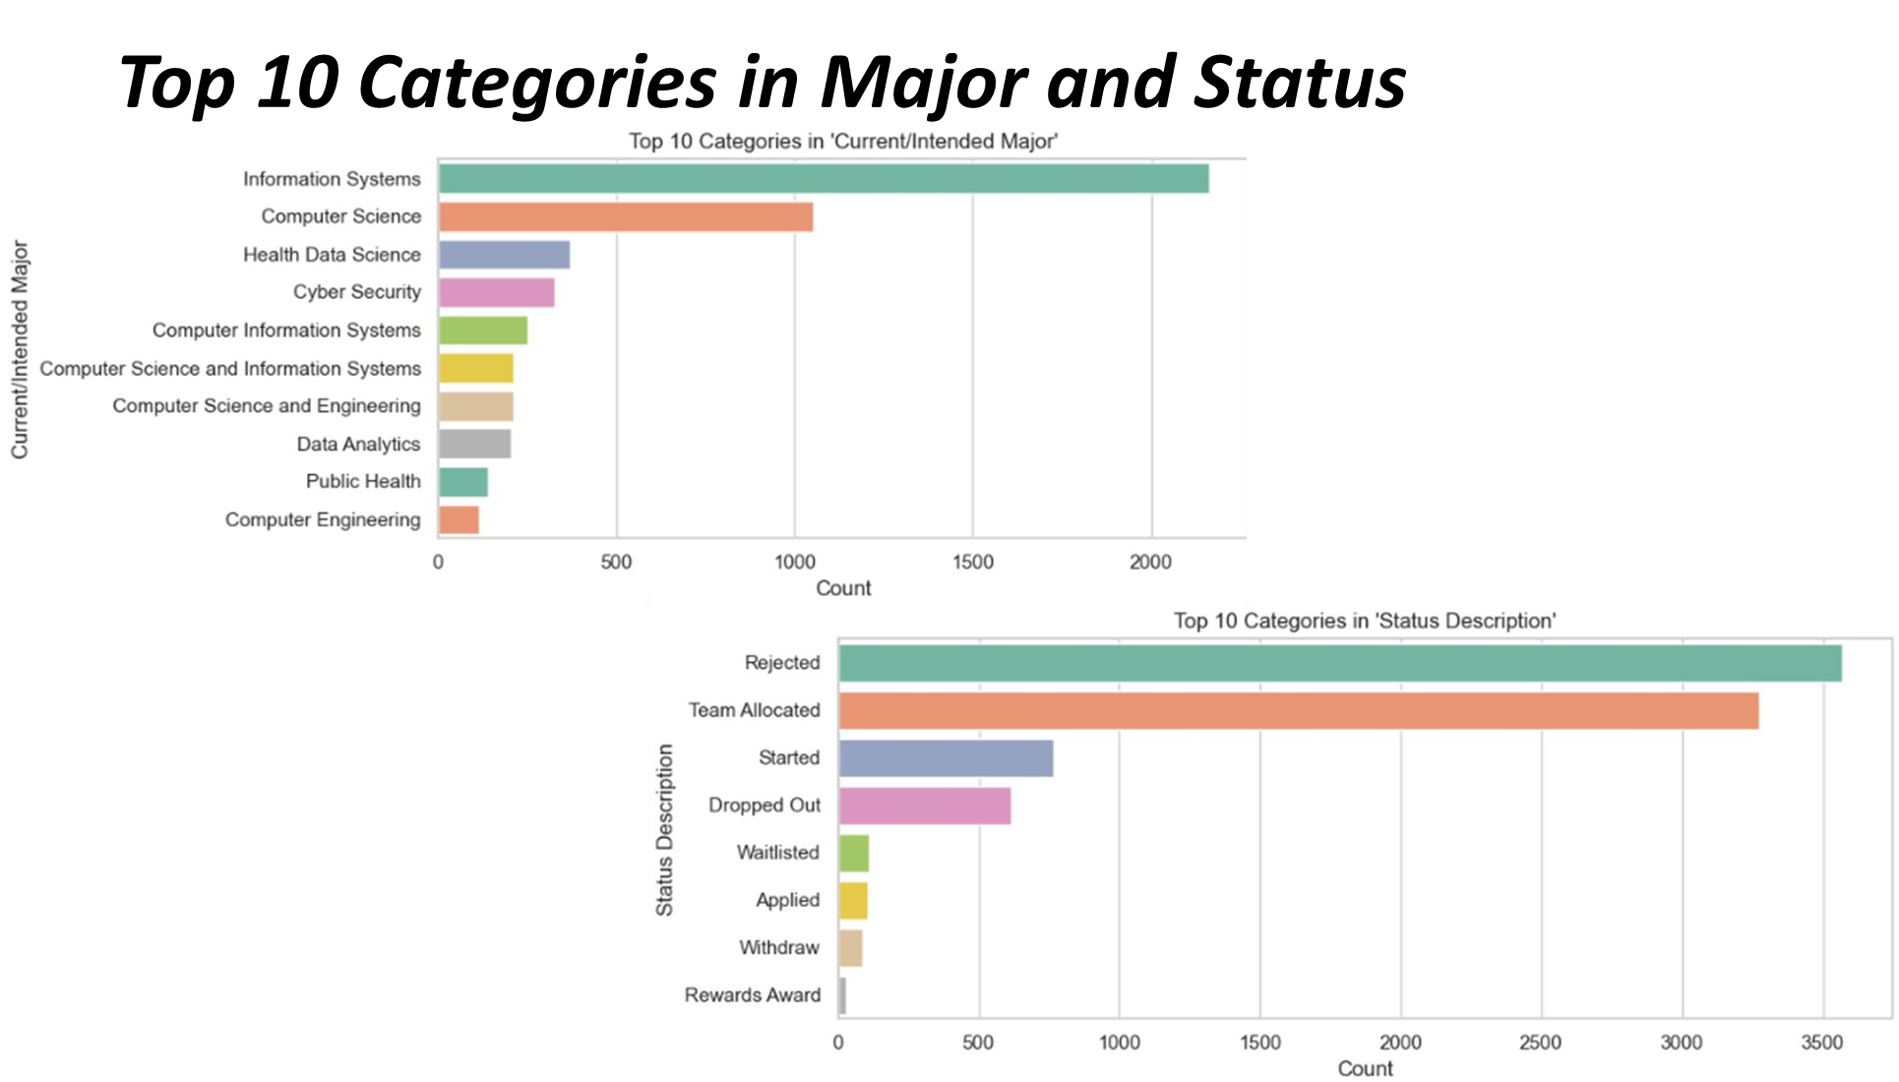

Slide 33
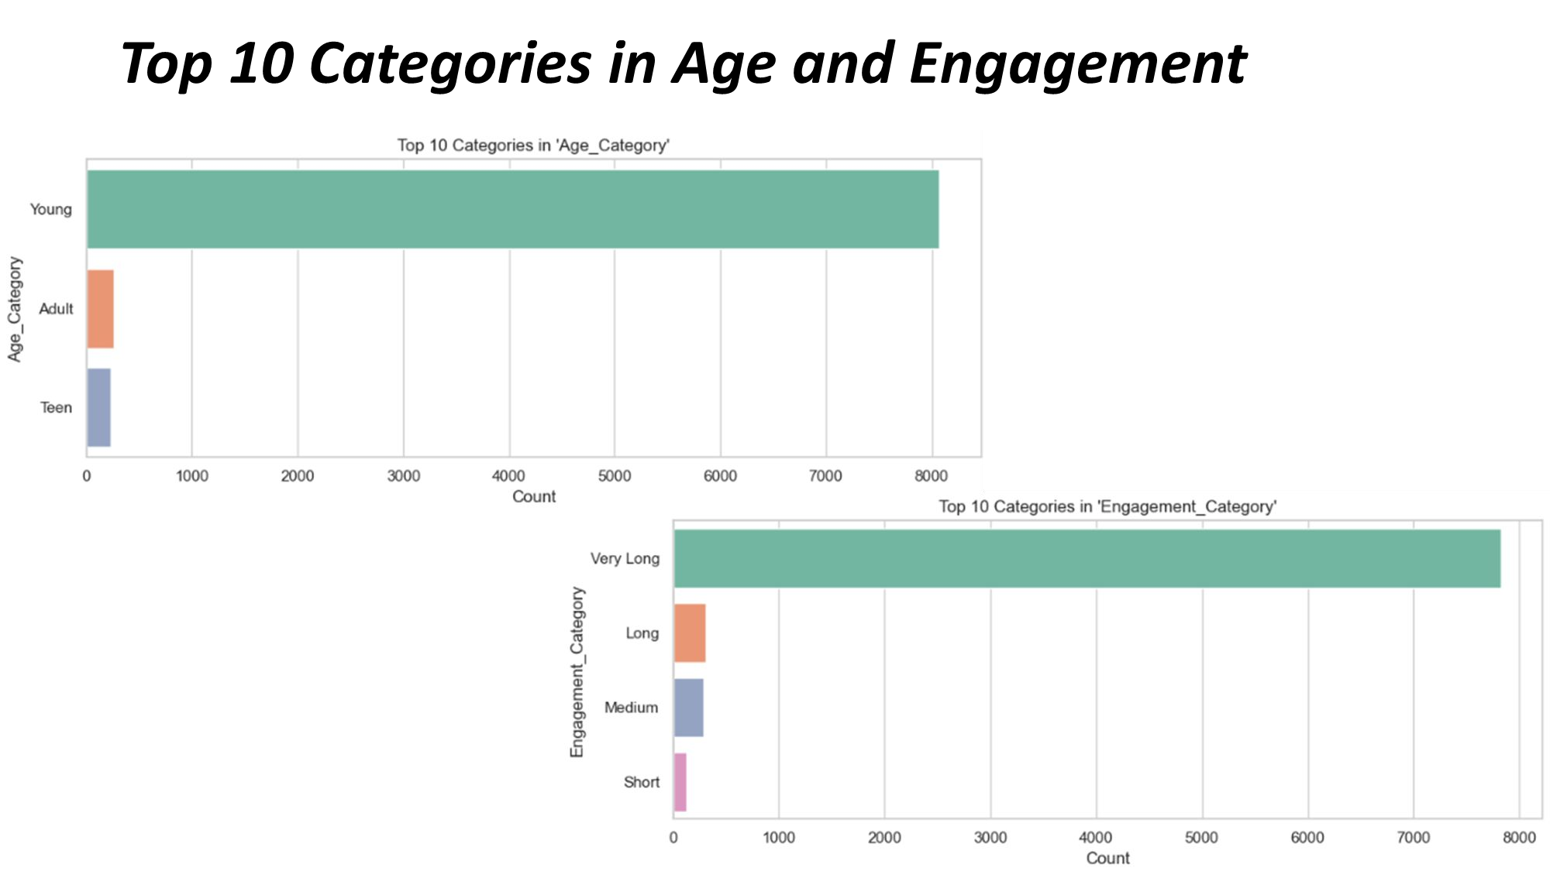

Slide 34
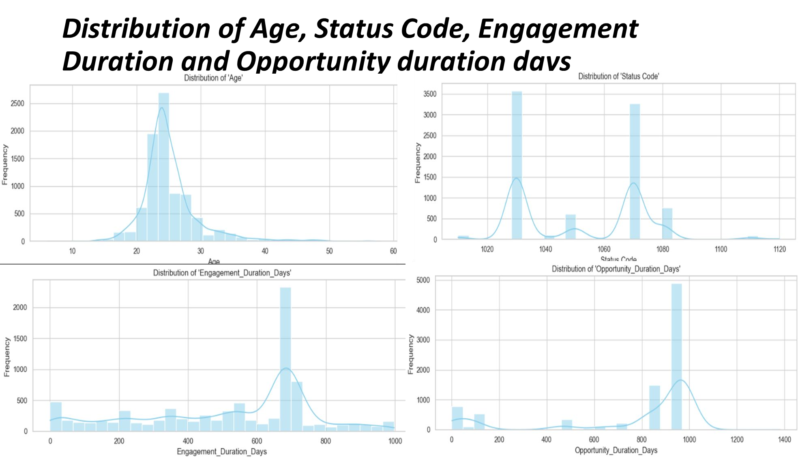

Slide 35
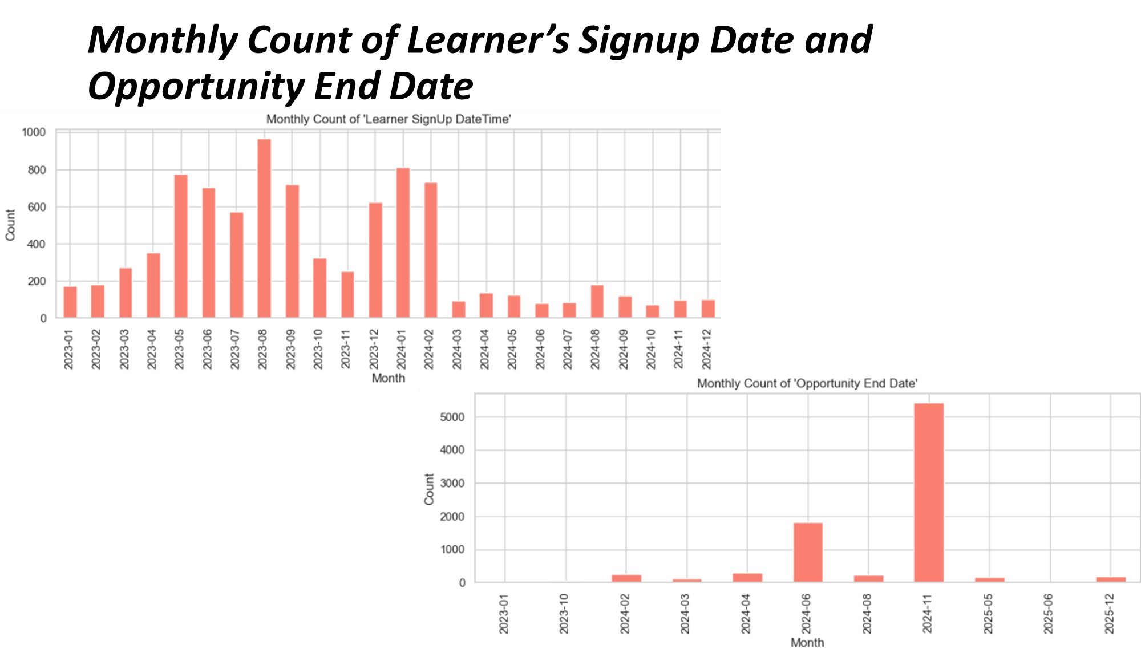

Slide 36
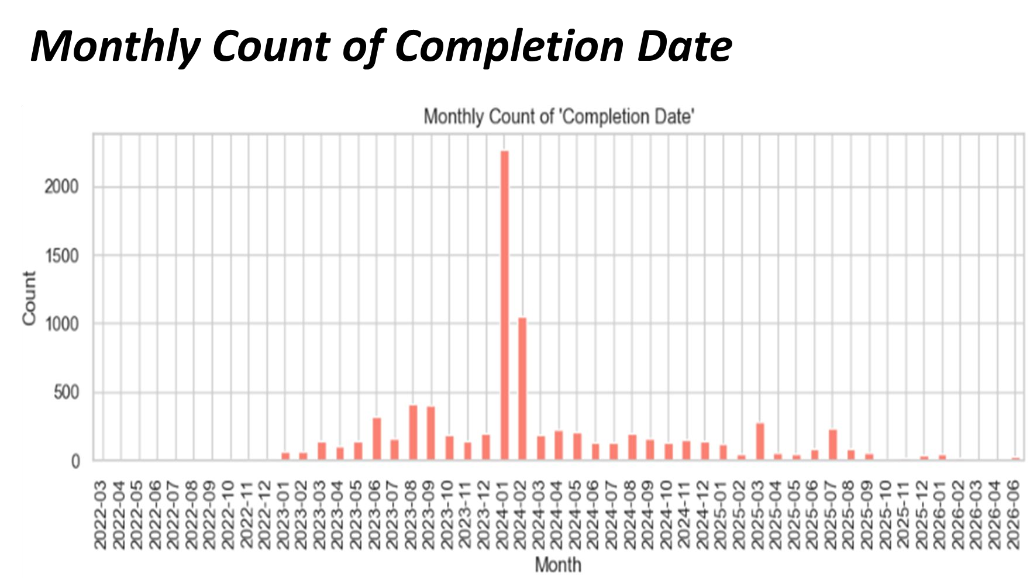

Slide 37
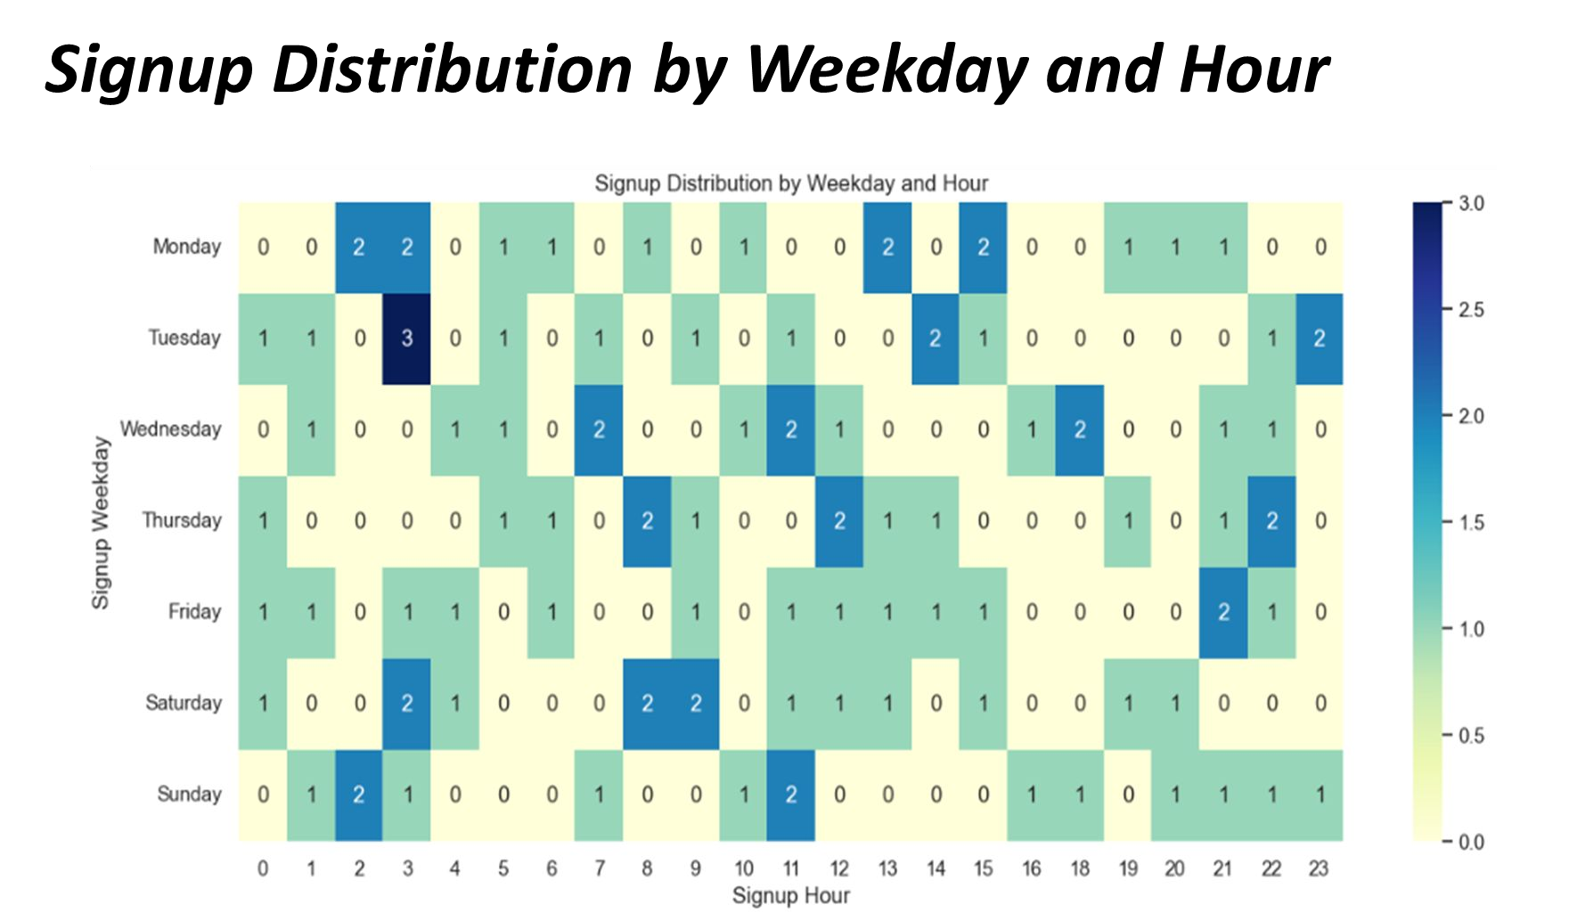

Slide 38
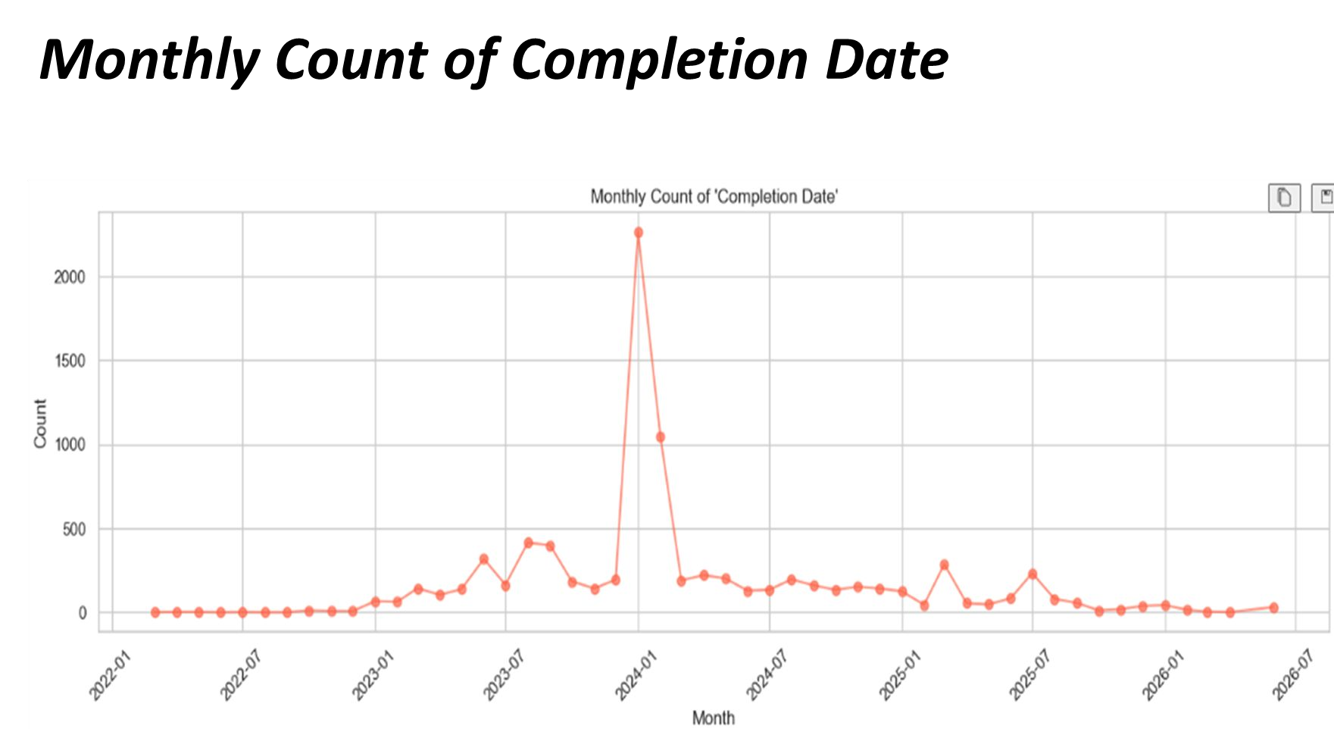

Slide 39
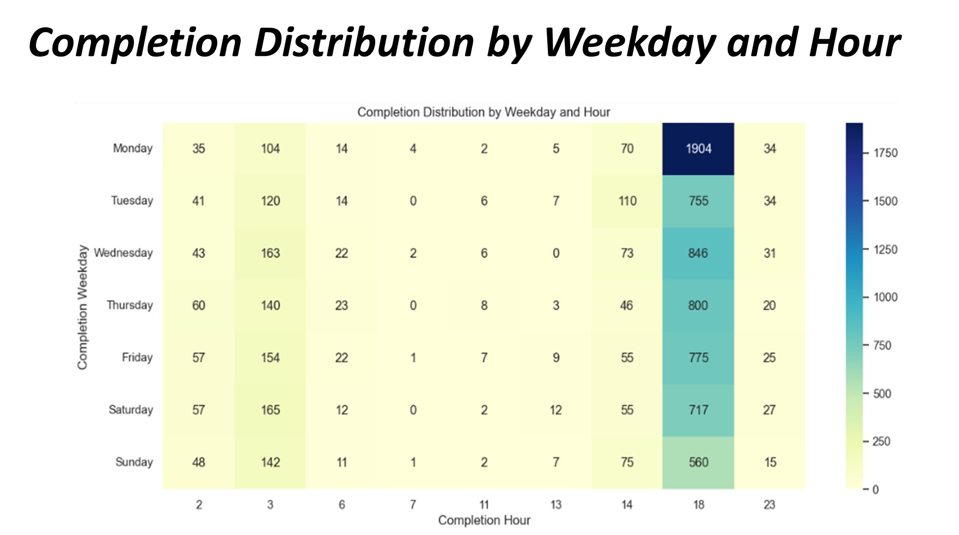

Slide 40
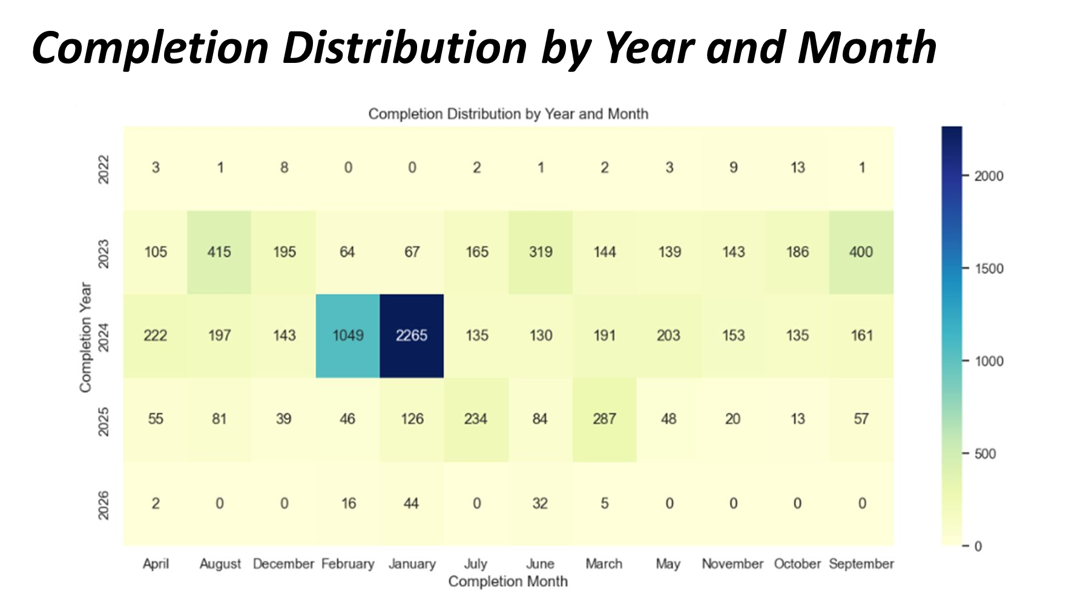

Slide 41
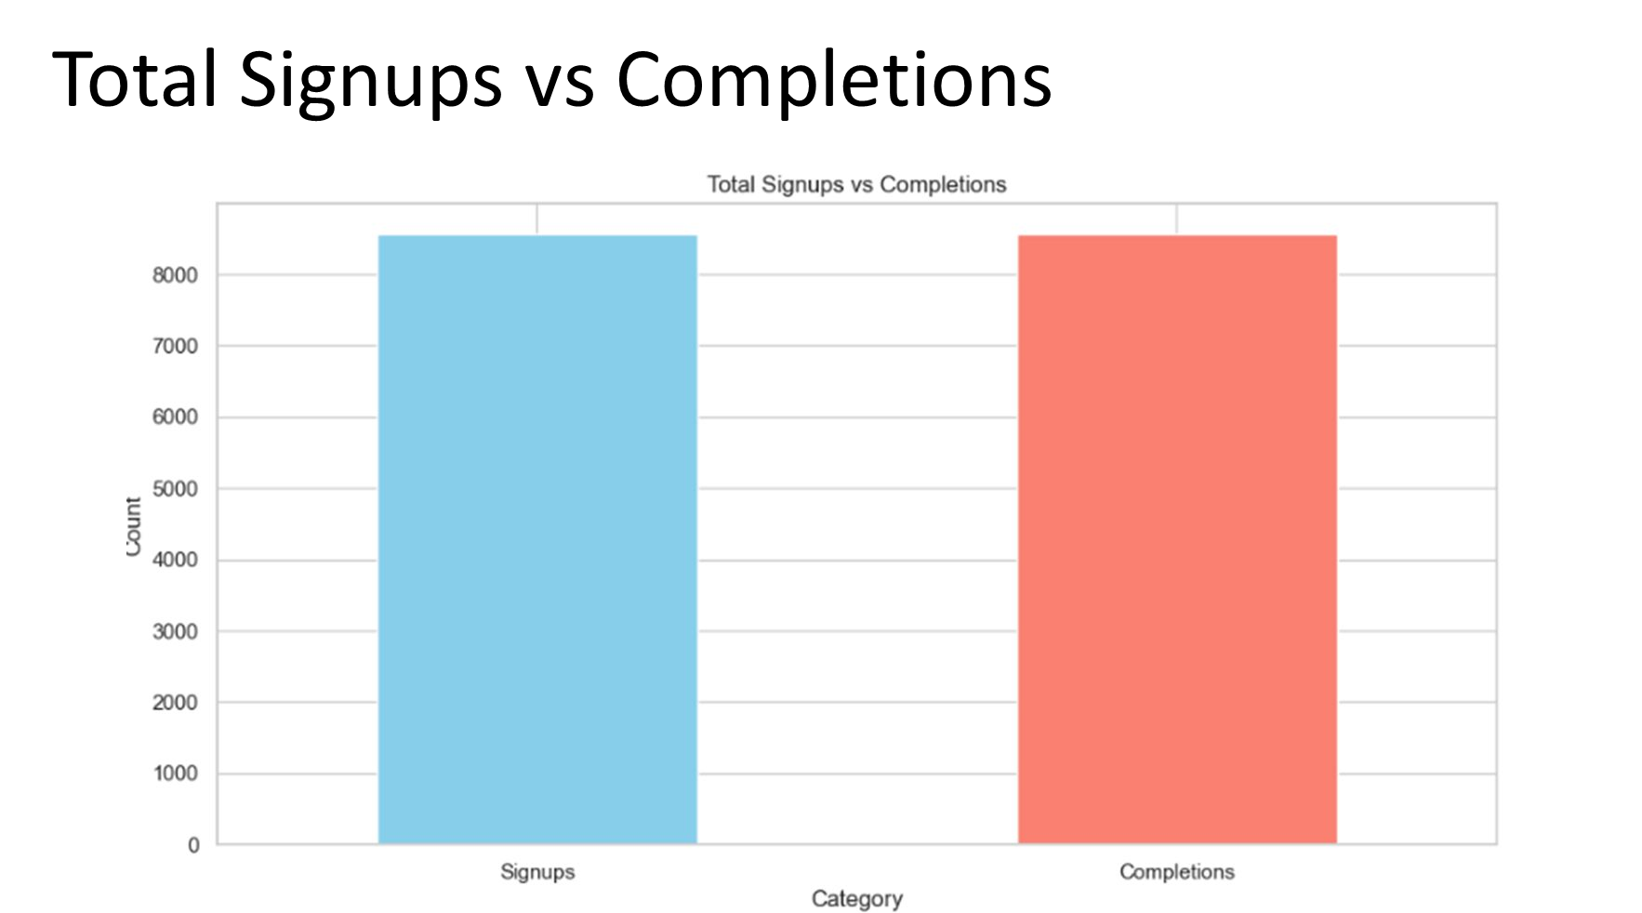

Slide 42
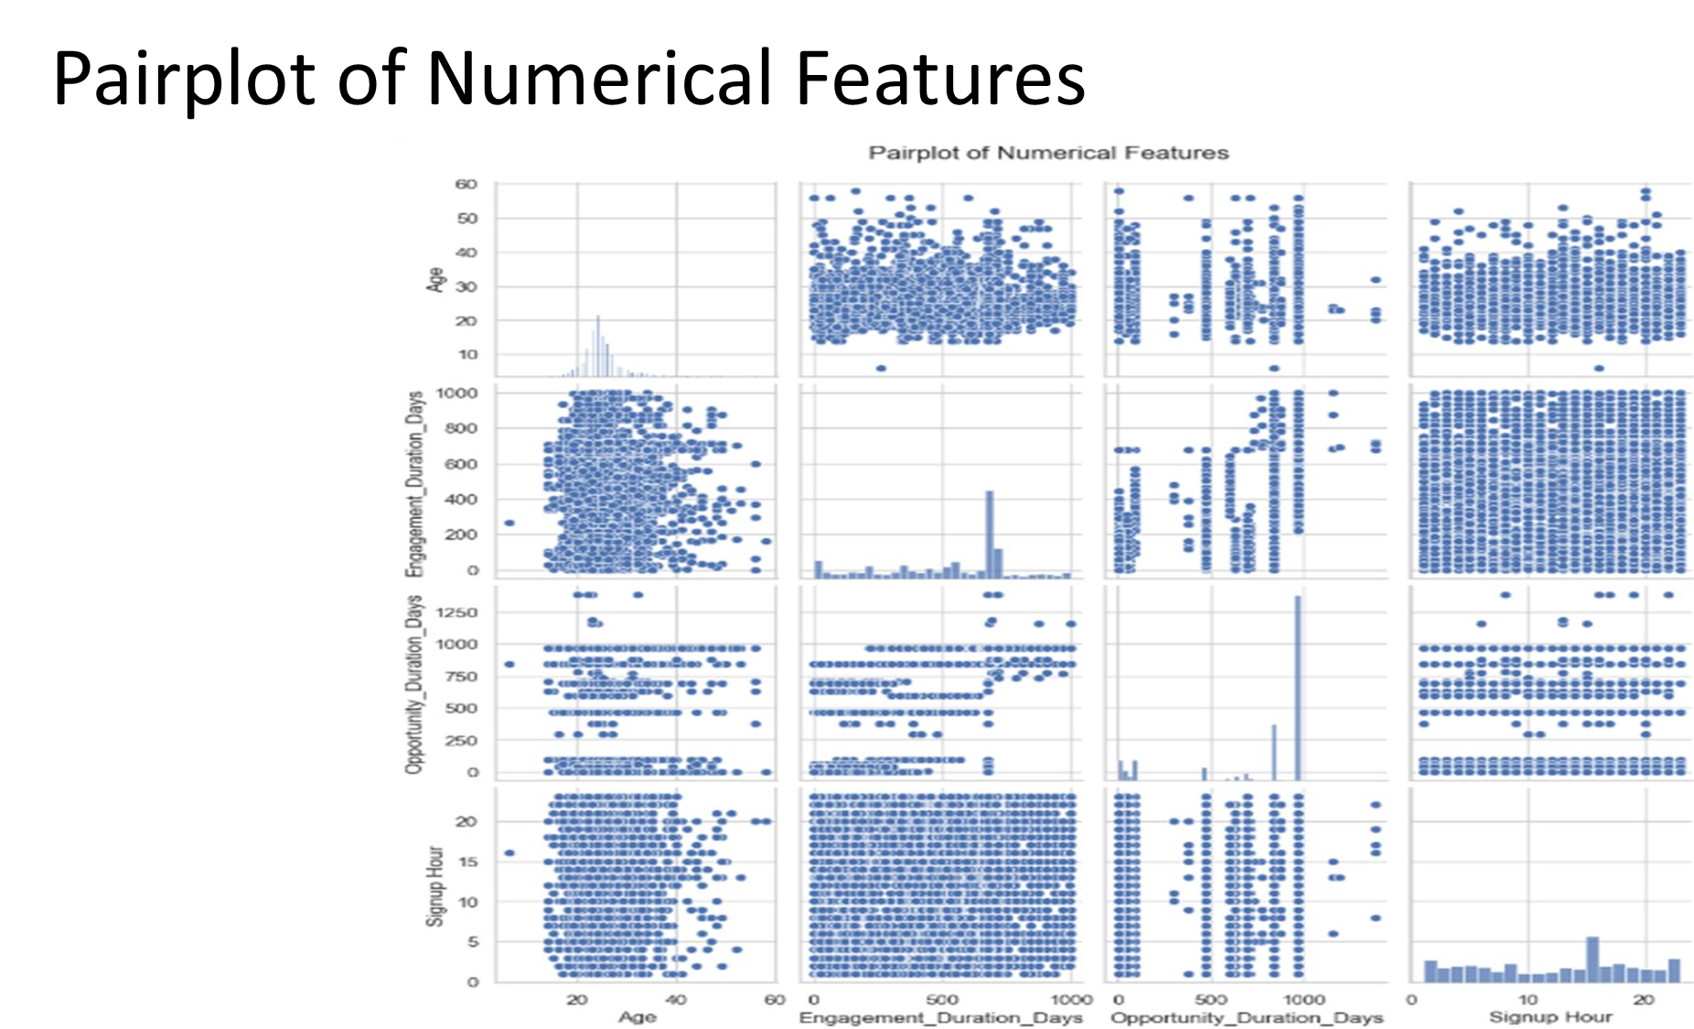

Slide 43
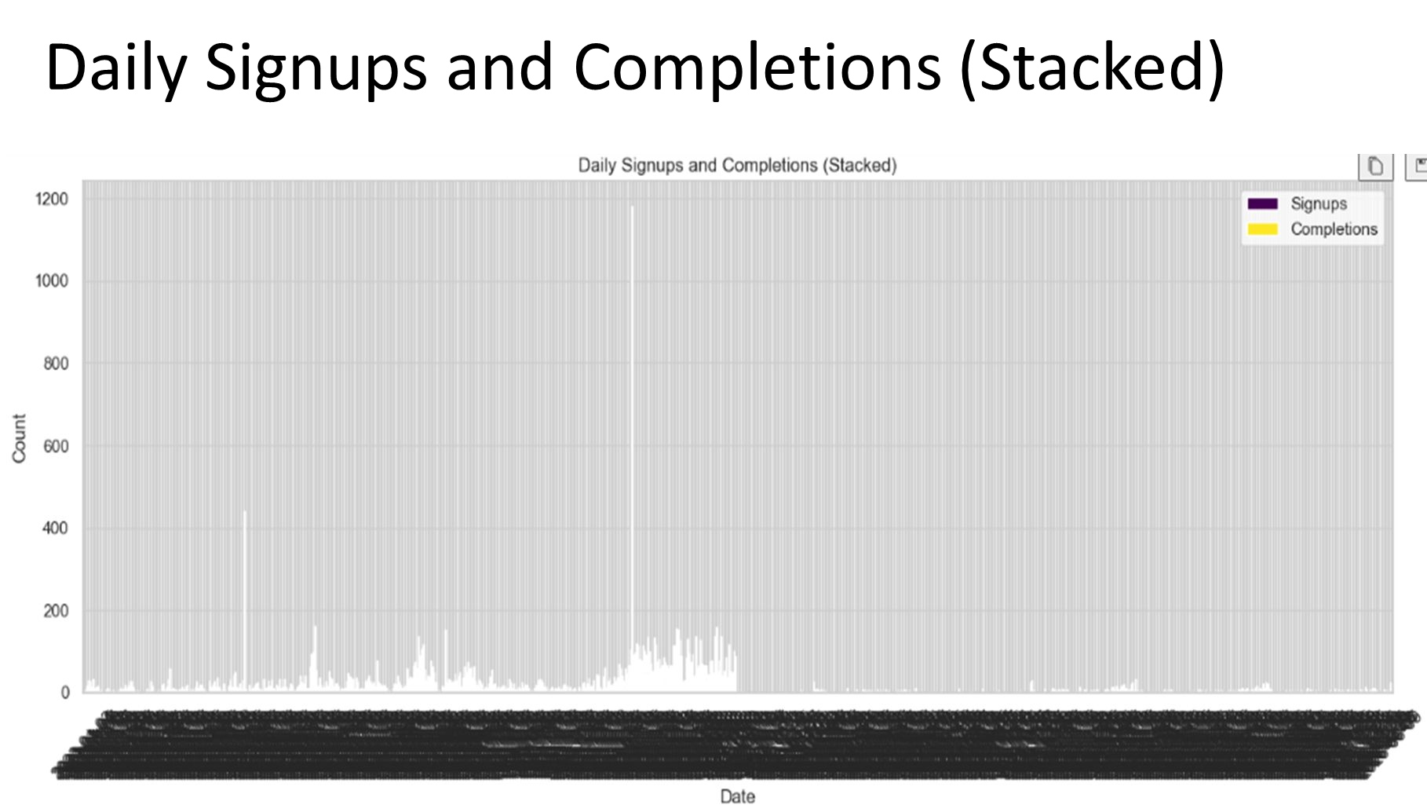

Slide 44
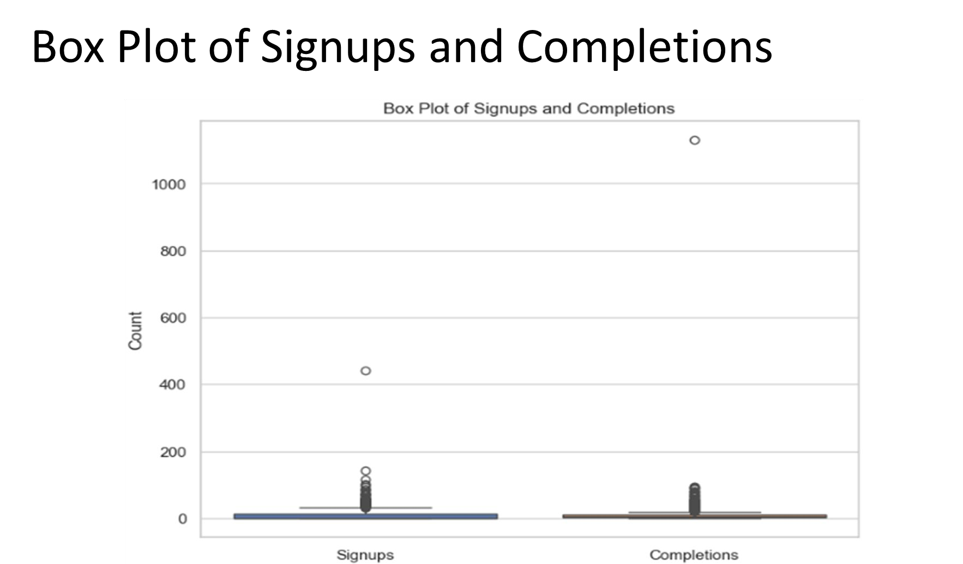

Slide 45
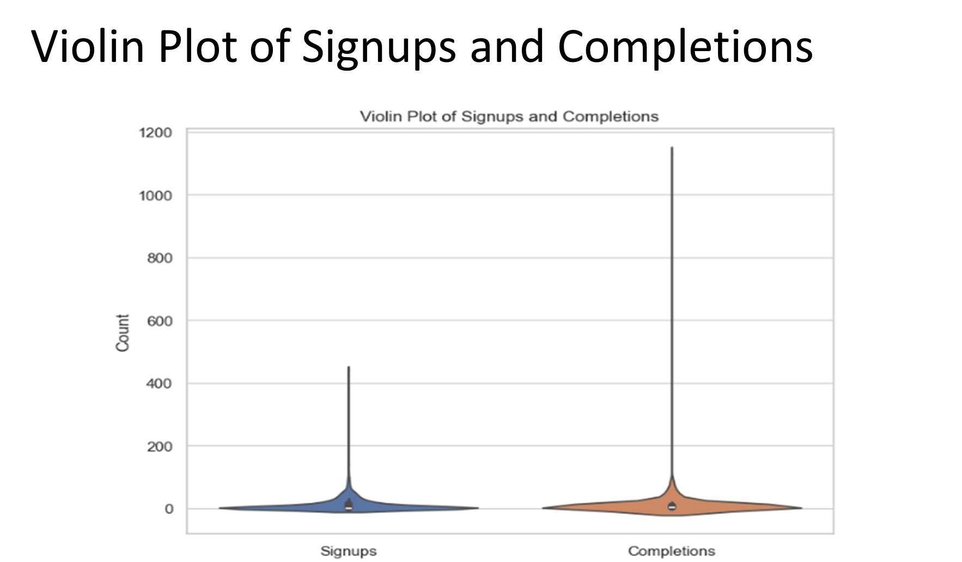

Slide 46
Week 3 Churn analysis
Churn analysis helps identify students likely to drop out by examining patterns in engagement, status, and demographics. It enables early intervention, targeted support, and program improvements, ultimately boosting retention and student satisfaction through proactive, data-driven strategies.
The dataset of 8,558 entries with 27 clean, structured columns offers rich demographic, academic, and behavioral insights. Key fields like Churning_Status, Engagement_Duration_Days, Age, Gender, and Opportunity Category enable powerful churn prediction and student retention analysis.

Slide 47
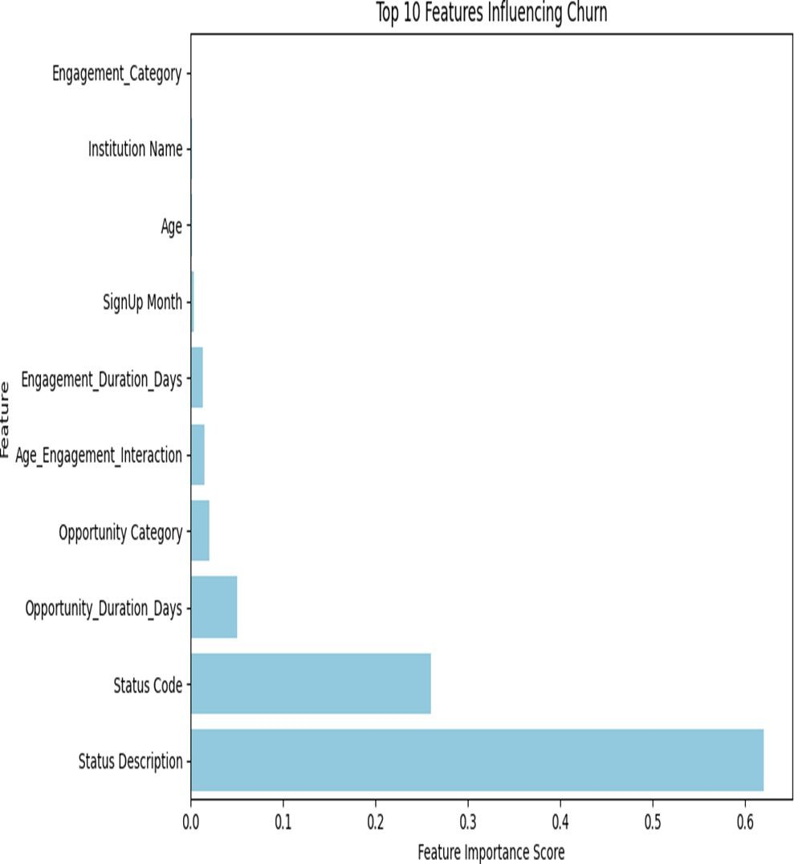

Slide 48
Status Description is Key:
●The most influential factor is Status Description, meaning the student's current status (e.g., enrolled, started, dropped) strongly predicts dropout.
Process Stage Matters:
●Status Code and Opportunity_Duration_Days are significant.This suggests how far the student progressed and how long they were engaged plays a big role in predicting churn.
●
Engagement is Low but Relevant:

Slide 49
●Engagement_Duration_Days and Age_Engagement_Interaction have minor influence, implying:
Students who engage longer or more consistently are slightly less likely to drop out.
Engagement is Low but Relevant:
●Engagement_Duration_Days and Age_Engagement_Interaction have minor influence, implying:Students who engage longer or more consistently are slightly less likely to drop out.
●
Demographics & Sign-up Info Have Little Impact:
●Variables like Age, Institution Name, and SignUp Month have very low importance, suggesting:Dropout is less about who the student is and more about what stage they're in and how they behave during the course.

Slide 50
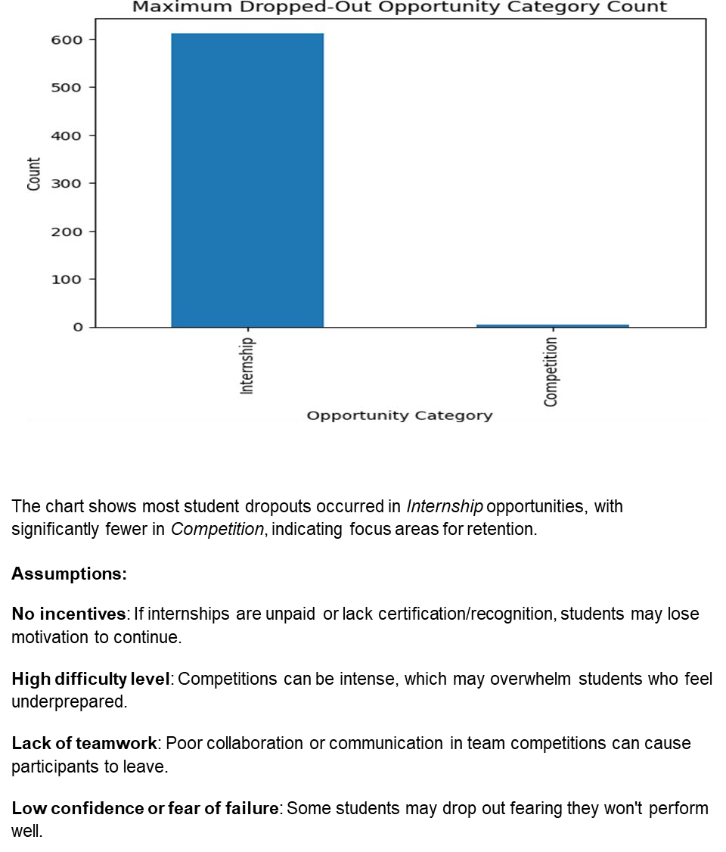

Slide 51
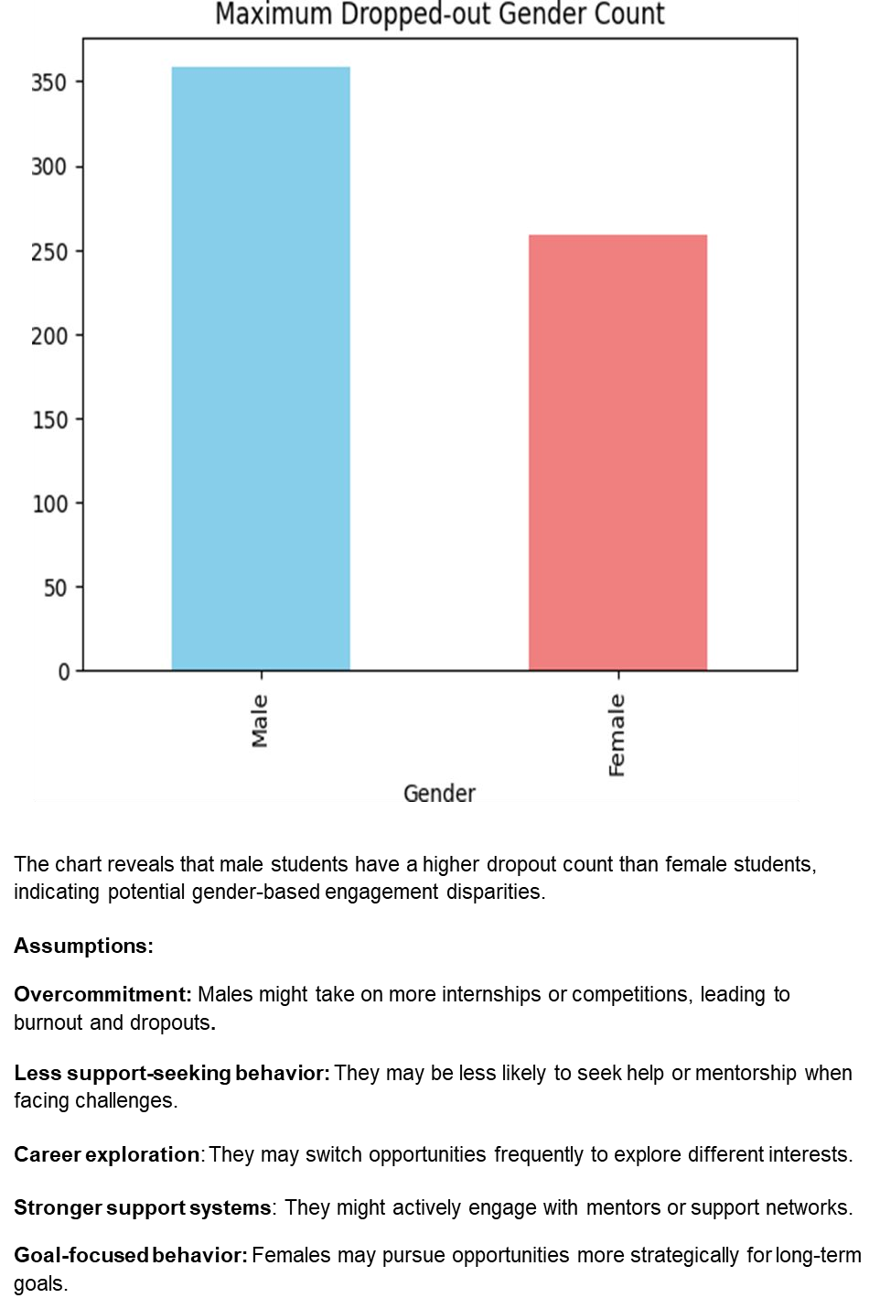

Slide 52
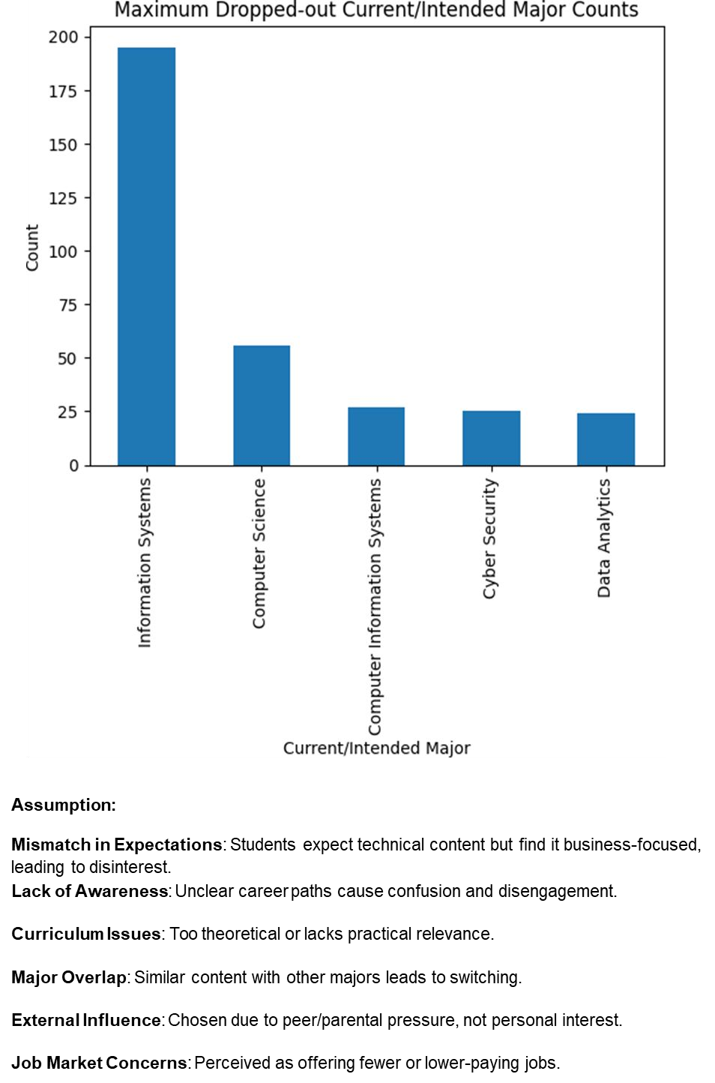

Slide 53
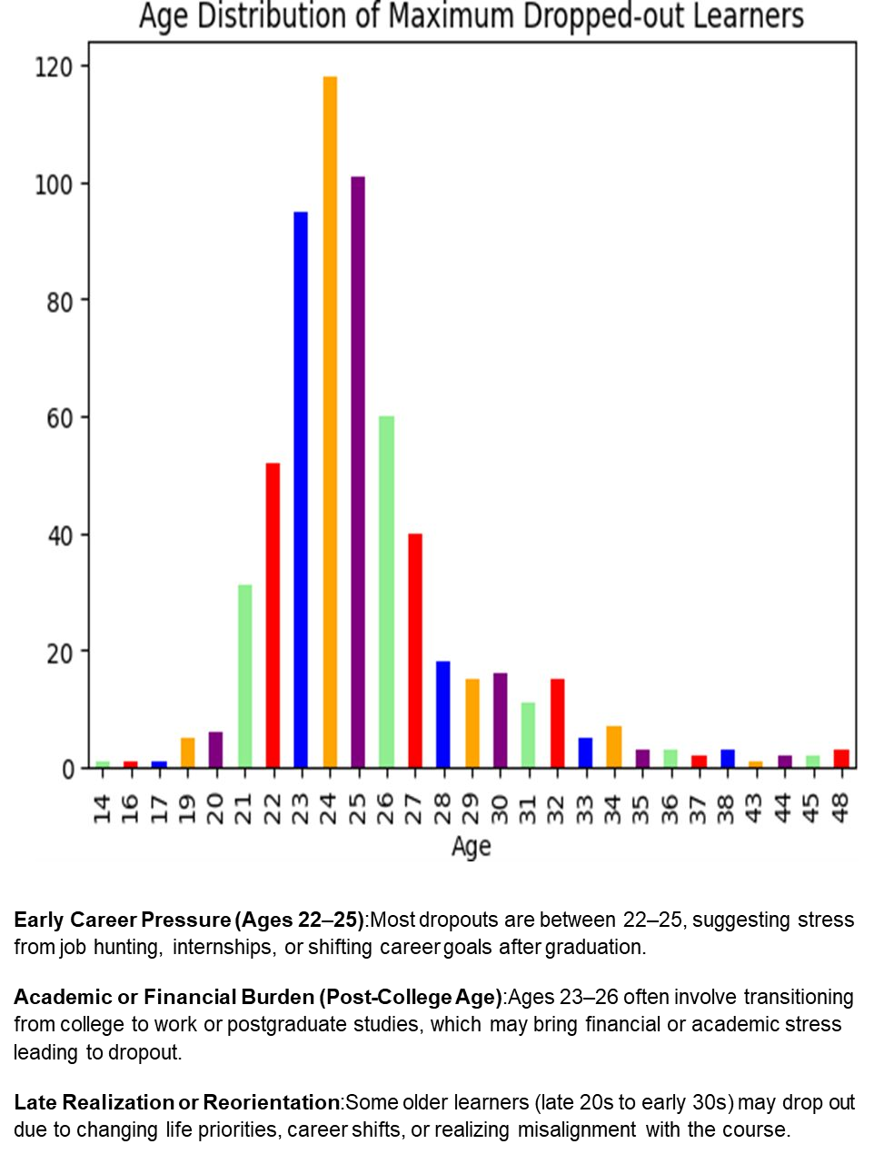

Slide 54
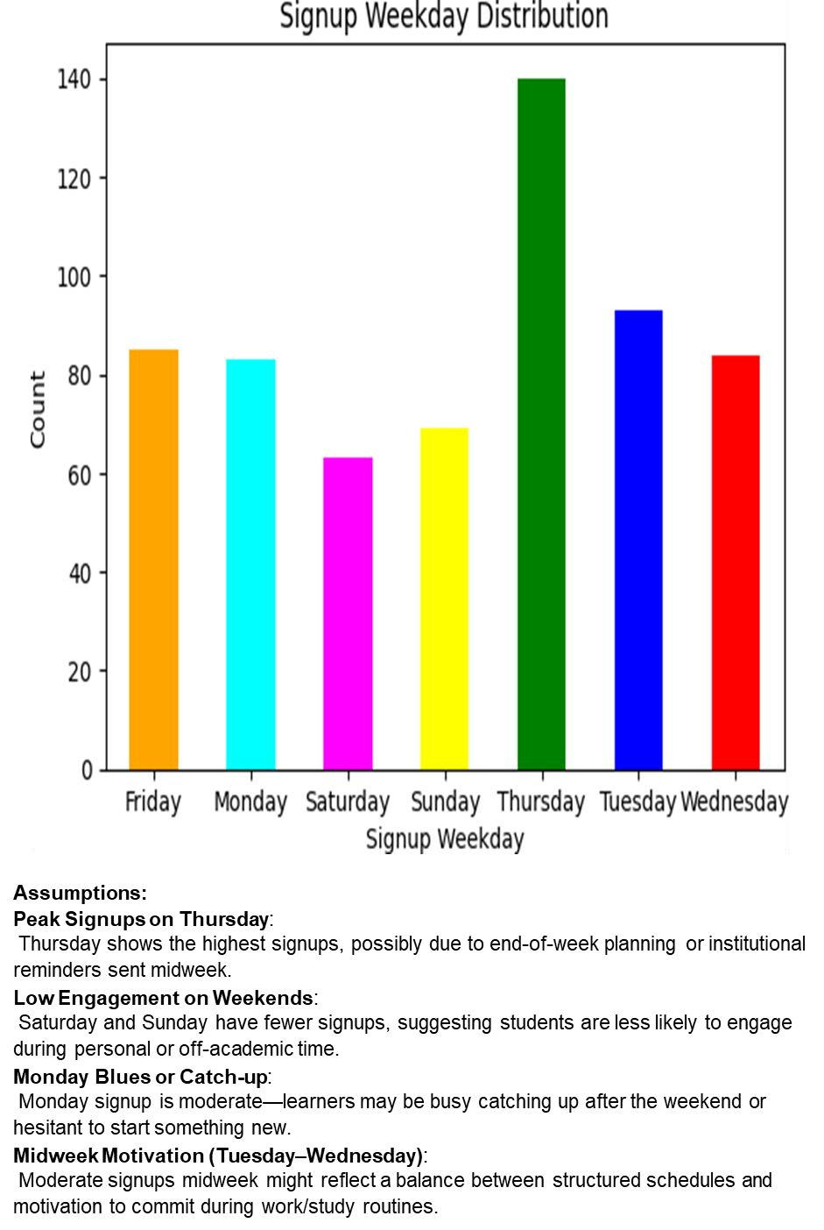

Slide 55
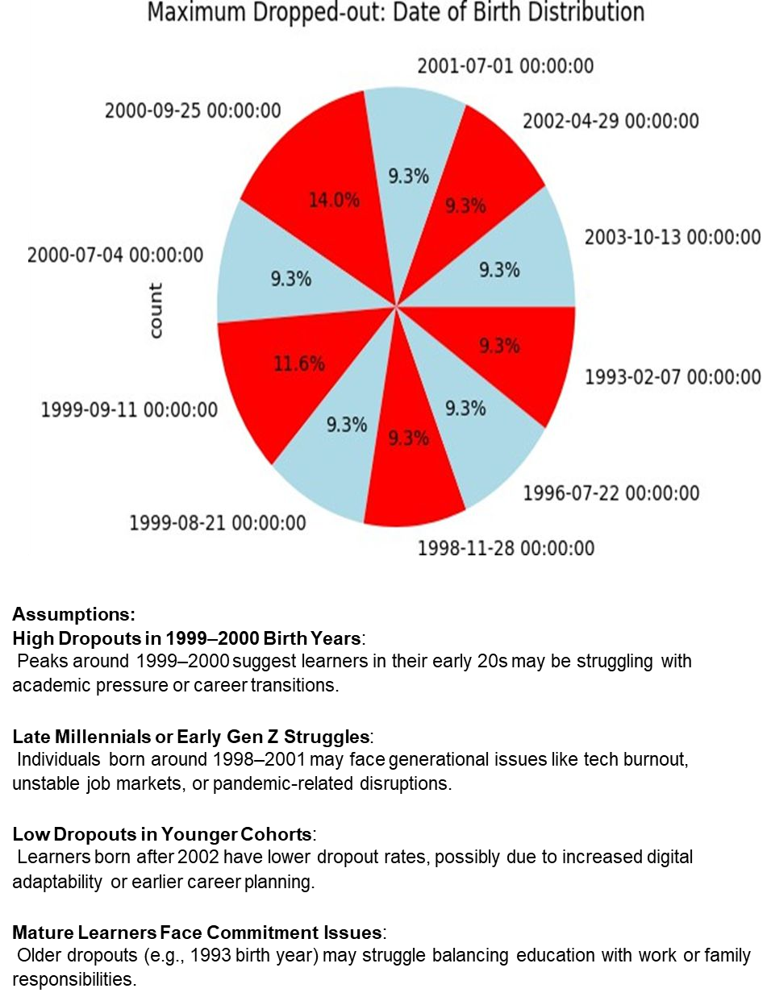

Slide 56
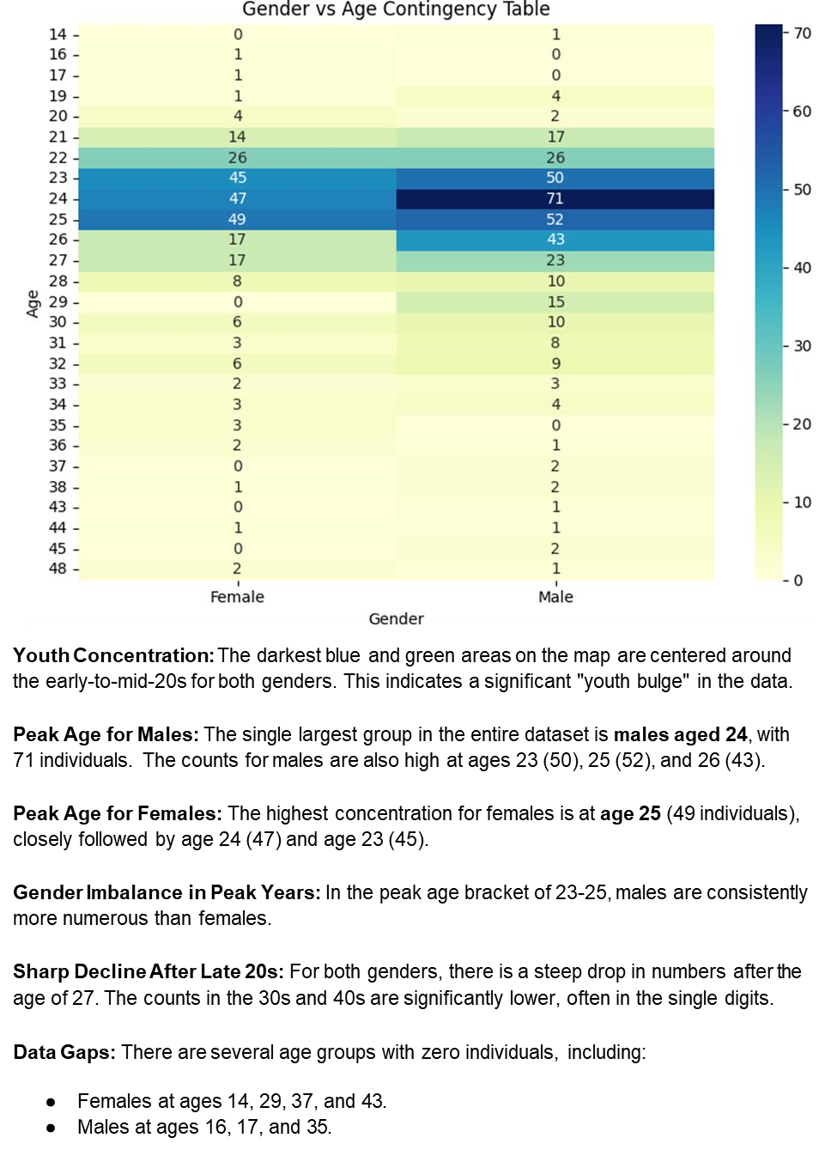

Slide 57
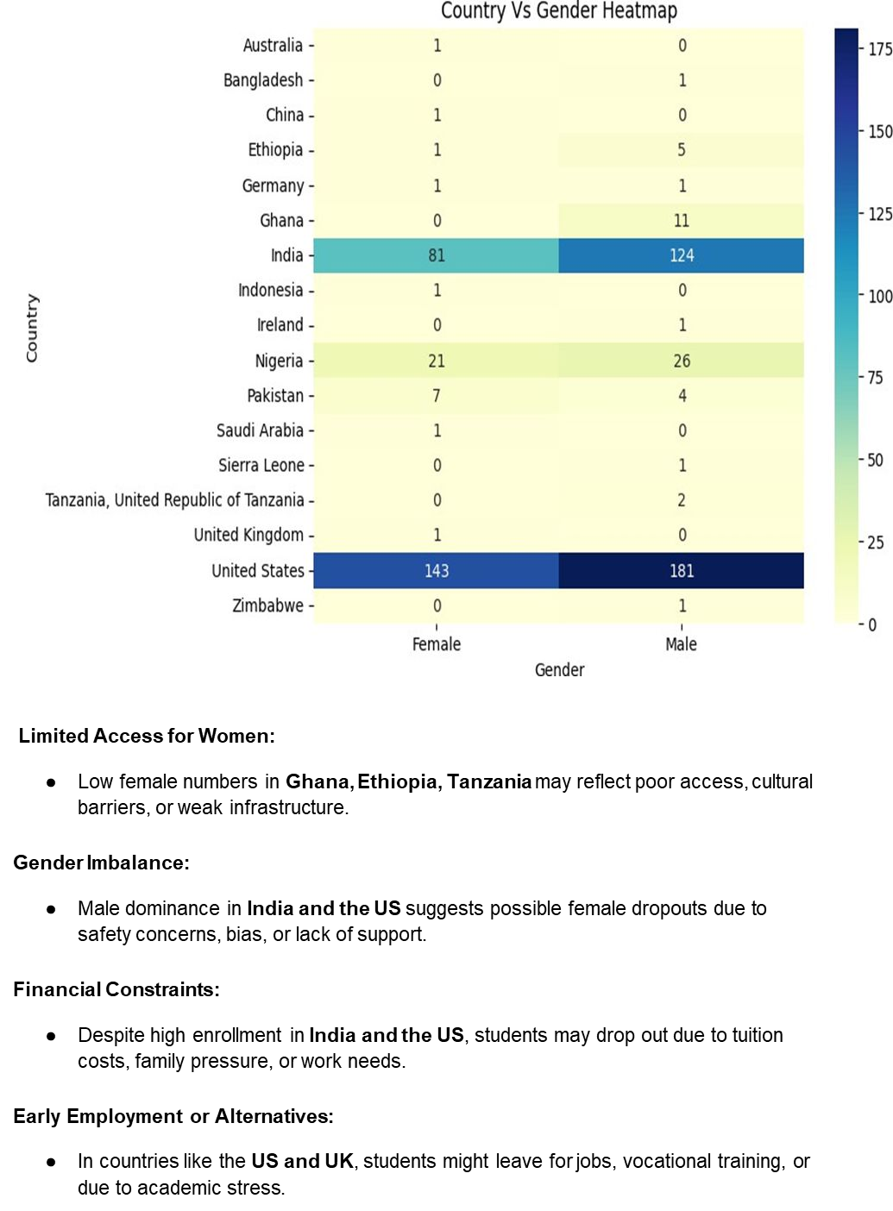

Slide 58
Week 4 Recommendation System
This script is part of a student retention Recommendation System using a Random Forest Classifier. It processes a single student's data to predict dropout likelihood and suggest interventions.
Key Steps:
Feature Extraction: Converts raw input (e.g., birthdate, gender, country, course data) into numerical features like age, signup month, engagement duration.
Label Encoding: Converts categorical values (e.g., country, status) to numeric codes using LabelEncoder,
trained on a reference dataset (df).
Feature Vector Construction: Combines all features into a structured NumPy array matching the model’s expected input.
Scaling: Applies pre-trained scalers (e.g., StandardScaler) if needed
Prediction: The model predicts whether the student will drop out (1) or continue (0).
Recommendations: If dropout is predicted, it suggests supportive actions like academic help, counseling, or engagement boosts.

Slide 59
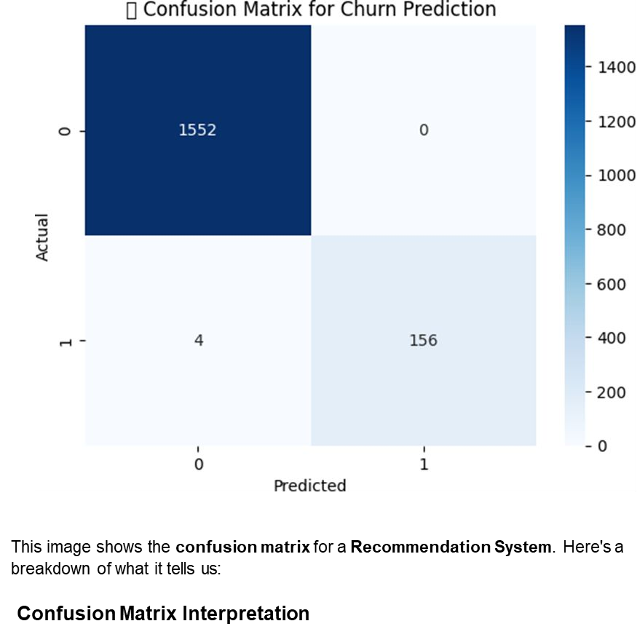

Slide 60


Slide 61


Slide 63


Slide 64
This graph shows a predicted dropout probability of 0.63 (63%) for a student.
Moderate to High Risk: There's a 63% chance the student may drop out.
●
Action Needed: This student should be monitored closely. Consider interventions like:
●
○Academic or peer support
○
○Motivation boosting activities
○
○Counseling or check-ins
Early action could help improve retention for this student.
Recommendation System
LINK:https://drive.google.com/file/d/1wpW9GNERpglzW4iKELeb9R1IjO_WTGS4/ view?usp=sharing

